Slide 1
Complexity of Rigor
Sample Items
Grades 3-5
Grades 6-8
High School

Slide 2
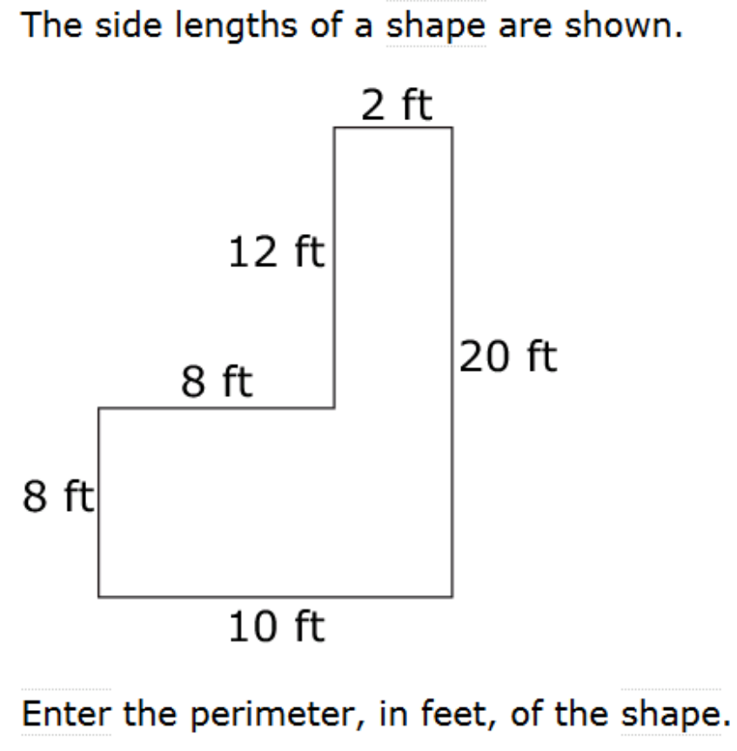

Grade 3
Procedural | Conceptual | Application
1 | 1 | 0
In this Grade 3 item the addends are within the limits for Grades 1-2 and the concept (perimeter) is at grade level.
This item is from the Smarter Balanced Assessment Consortium: Mathematics Practice Test Scoring Guide Grade 3, 08/01/2016, p. 10.

Slide 3
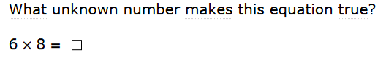
Grade 3
Procedural | Conceptual | Application
2 | 0 | 0
This Grade 3 item matches the expectation in the standards for students to know single digit products by memory.
This item is from the Smarter Balanced Assessment Consortium: Mathematics Practice Test Scoring Guide Grade 3, 08/01/2016, p. 13.

Slide 4
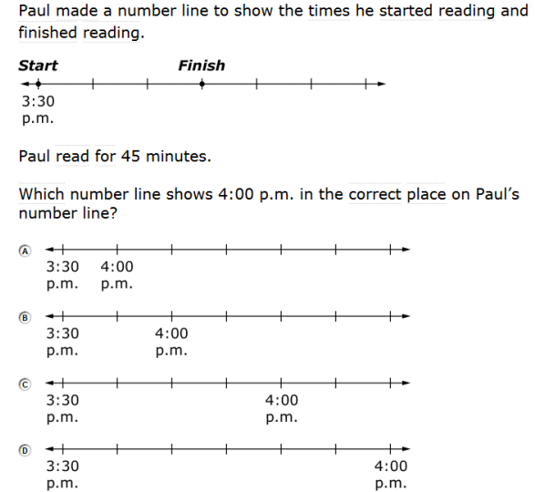
Grade 3
Procedural | Conceptual | Application
0 | 2 | 1
In this Grade 3 item students must connect concepts (connecting number line intervals to time) with a strategy. The mathematics in the application (Paul read for 45 minutes, starting at 3:30) is directly indicated.
This item is from the Smarter Balanced Assessment Consortium: Mathematics Practice Test Scoring Guide Grade 3, 08/01/2016, p. 18.
Notes:
For contrast, consider a problem that just asked “What time did Paul finish reading?” which would be a level 1 application. Most of the heavy lifting here is on connecting mathematical concepts of time with the representation on a number line and deep understanding of intervals on a number line.

Slide 5
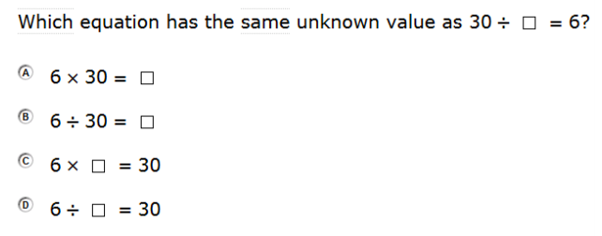
Grade 3
Procedural | Conceptual | Application
2 | 1
In this Grade 3 item, students must either recognize the relationship between multiplication and division or use grade level fluency to determine which equations have the same unknown.
This item is from the Smarter Balanced Assessment Consortium: Mathematics Practice Test Scoring Guide Grade 3, 08/01/2016, p. 14.

Slide 6
Grade 4
Procedural | Conceptual | Application
3 | 0 | 2
Hayley has 272 beads. She buys 38 more beads. She will use 89 beads to make bracelets and the rest to make necklaces. She will use 9 beads for each necklace.
What is the greatest number of necklaces Hayley can make?
Enter your answer in the box
In this Grade 4 item the number of different procedures requires organization and perseverance. Students have to interpret the context to decide which procedures to use.
This item is from the PARCC Grade 4 Mathematics Practice Test, p. 40.

Slide 7
Grade 4
Procedural | Conceptual | Application
1 | 0 | 1
A baker has 159 cups of brown sugar and 264 cups of white sugar. How many total cups of sugar does the baker have?
In this Grade 4 item, the application makes the expected mathematical procedure clear. Adding two three-digit numbers is a fluency expectation from grade 3.
This item is from the Smarter Balanced Assessment Consortium: Mathematics Practice Test Scoring Guide Grade 4, 08/01/2016.

Slide 8
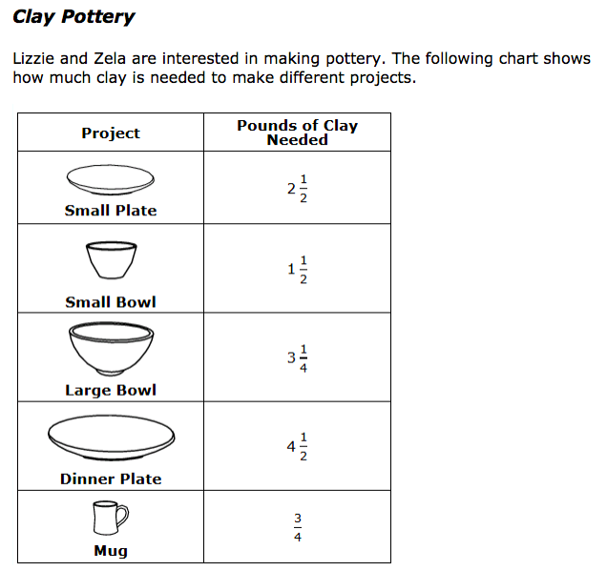
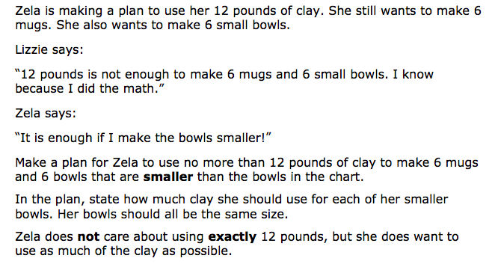
Grade 5
Procedural | Conceptual | Application
3 | 2 | 3
This is part 5 of a Grade 5 task. Students need to formulate the problem, drawing on the information needed. They need to compute one or more solutions and then interpret those with respect to what is reasonable for the problem. Students will likely use an unconventional combination of procedures. Students will need to connect concepts with procedures or strategies.
This item is from the Smarter Balanced Assessment Consortium: Clay Pottery Performance Task Grade 5 Mathematics Practice Test Scoring Guide, January 2017. pp. 2-4
Notes:
In grade 5 student have not proceduralized division of non-unit fractions by whole numbers.

Slide 9
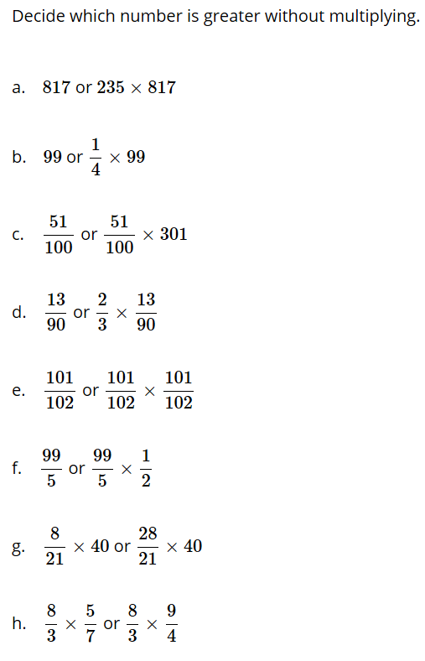
Grade 5
Procedural | Conceptual | Application
0 | 3 | 0
In this Grade 5 item students must use a sophisticated line of reasoning to compare the values.
This item is from the tasks for 5.NF.B.5 at Illustrative Mathematics.

Slide 10
Grade 6
Procedural | Conceptual | Application
1 | 0 | 1
Heather earns $8.00 per hour for walking a dog. How many hours must she work to earn $256.00?
In this Grade 6 item (administered without a calculator) the required computation is below grade level. As to application, the required mathematics is rather obvious at this grade level.
This item is from the North Carolina READY End-of-Grade Assessment Mathematics Grade 6 Student Booklet, p. 7.

Slide 11
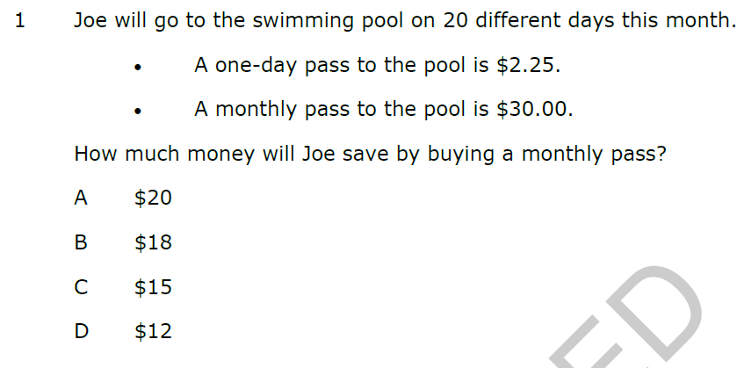
Grade 6
Procedural | Conceptual | Application
2 | 0 | 1
In this Grade 6 item the required mathematics is made obvious by the application. The procedures are at grade level.
This item is from the North Carolina READY End-of-Grade Assessment Mathematics Grade 6 Student Booklet, p. 2.

Slide 12
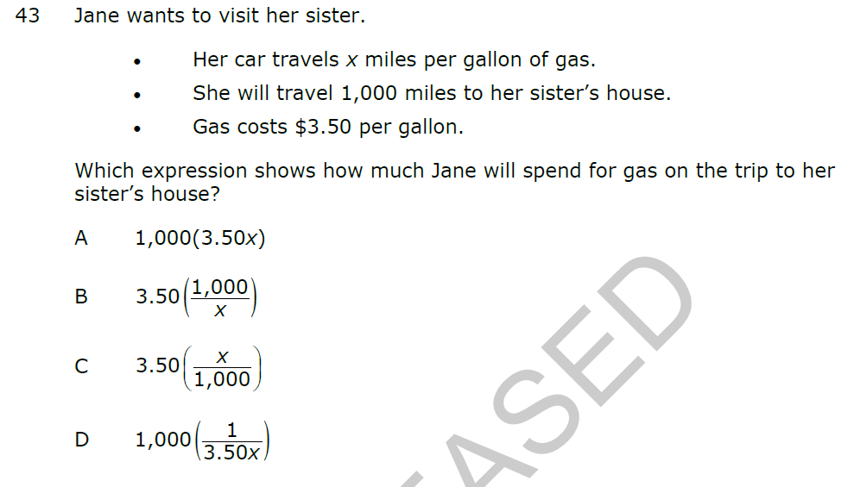
Grade 6
Procedural | Conceptual | Application
0 | 2 | 2
This Grade 6 item requires some interpretation of the context to relate multiple concepts.
This item is from the North Carolina READY End-of-Grade Assessment Mathematics Grade 6 Student Booklet, p. 22.

Slide 13
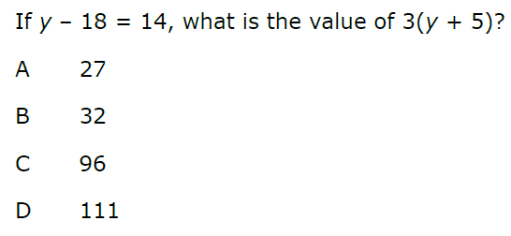
Grade 6
Procedural | Conceptual | Application
2 | 0 | 0
Solving an equation of this sort is at grade level in this Grade 6 item.
This item is from the North Carolina READY End-of-Grade Assessment Mathematics Grade 6 Student Booklet, p. 13.
Notes:
Calculator allowed

Slide 14
Grade 6
Procedural | Conceptual | Application
3 | 0 | 2
At a store, Susan selected a pumpkin that weighed 35.2 ounces.
Pumpkins cost $1.80 per pound
There are 16 ounces in 1 pound
How much did Susan’s pumpkin cost?
Express the answer as dollars.cents.
In this Grade 6 item (administered without a calculator), the procedure is level 3 due to the unfriendly numbers. In this case, the application must be interpreted to determine the procedures to use.
This item is from the North Carolina READY End-of-Grade Assessment Mathematics Grade 6 Student Booklet, p. 6.

Slide 15
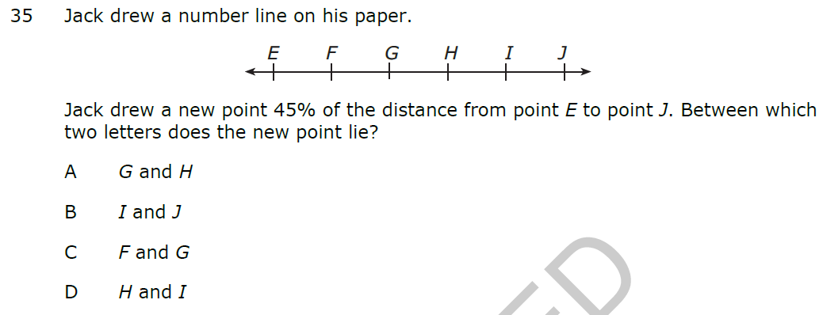
Grade 6
Procedural | Conceptual | Application
0 | 2 | 0
In this Grade 6 item the student must do some reasoning, but it is not sophisticated.
This item is from the North Carolina READY End-of-Grade Assessment Mathematics Grade 6 Student Booklet, p. 19.

Slide 16
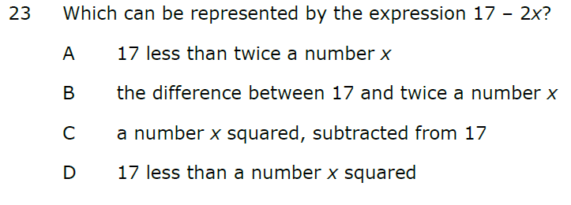
Grade 6
Procedural | Conceptual | Application
0 | 1 | 0
In this Grade 6 item students need only translate a simple expression into words.
This item is from the North Carolina READY End-of-Grade Assessment Mathematics Grade 6 Student Booklet, p. 12.

Slide 17
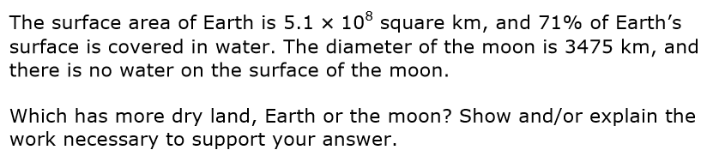
Grade 8
Procedural | Conceptual | Application
3 | 3 | 2
In this Grade 8 item students must demonstrate a sophisticated line of reasoning. Procedurally, the students work with an unconventional combination of procedures. The students must use the quantities in the context to determine the procedures and concepts to use.
This item is from the Smarter Balanced Scoring Guide For Selected Short-Text Mathematics Items (Field Test 2014), p. 17.
Notes:
Administered with calculator

Slide 18
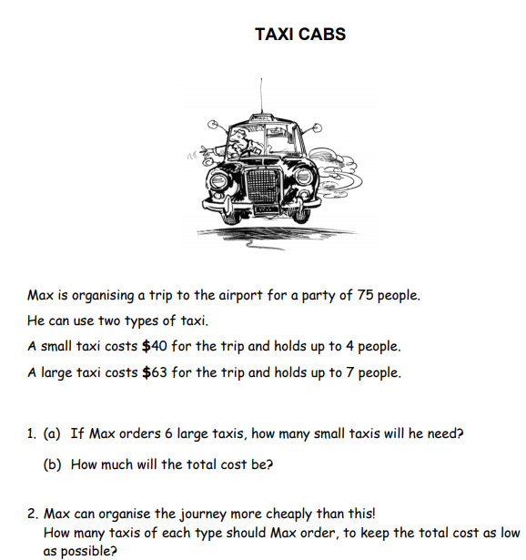
Middle School
Procedural | Conceptual | Application
1 | 0 | 3
In this middle school item, students need to use the application to determine the mathematics, and they need to formulate and interpret results. The required procedures (which are not the aim of the task) are below grade level.
This item, Taxi Cabs, is from the Mathematics Assessment Resource Service’s Summative Assessment Tasks and may be accessed here.

Slide 19
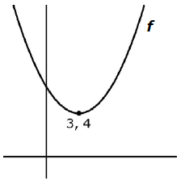

High School
The graph of a quadratic function $f$ is shown and the vertex is labeled with its coordinates. If $g\left(x\right)=f\left(x−1\right)+2$, what is the minimum value of $g$?
The minimum value of $g$ is [1, 2, 3, 4, 5, 6] because the minimum value for $f$ is [1, 2, 3, 4, 5, 6] and the graph of $g$ is shifted [up, down, left, right] from the graph of $f$ by [1, 2, 3, 4, 5, 6] units (in addition to the other shift).
Procedural | Conceptual | Application
0 | 2 | 0
In this high school task students are expected to relate multiple concepts.
This item is from the Smarter Balanced High School Claim 3 Specifications, p. 21.

Slide 20
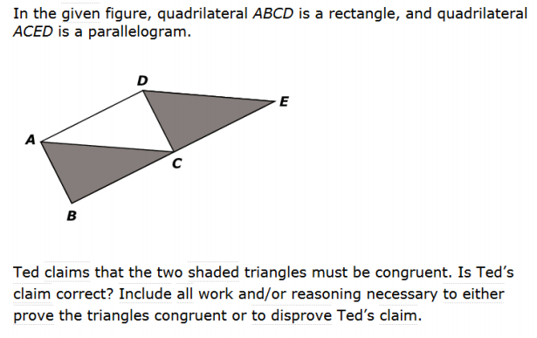
High School
Procedural | Conceptual | Application
0 | 3 | 0
In this high school task, students are required to evidence sophisticated reasoning through the construction of a proof.
This item is from the Smarter Balanced Assessment Consortium: Mathematics Practice Test Scoring Guide High School, 08/01/2016, p. 30.

Slide 21
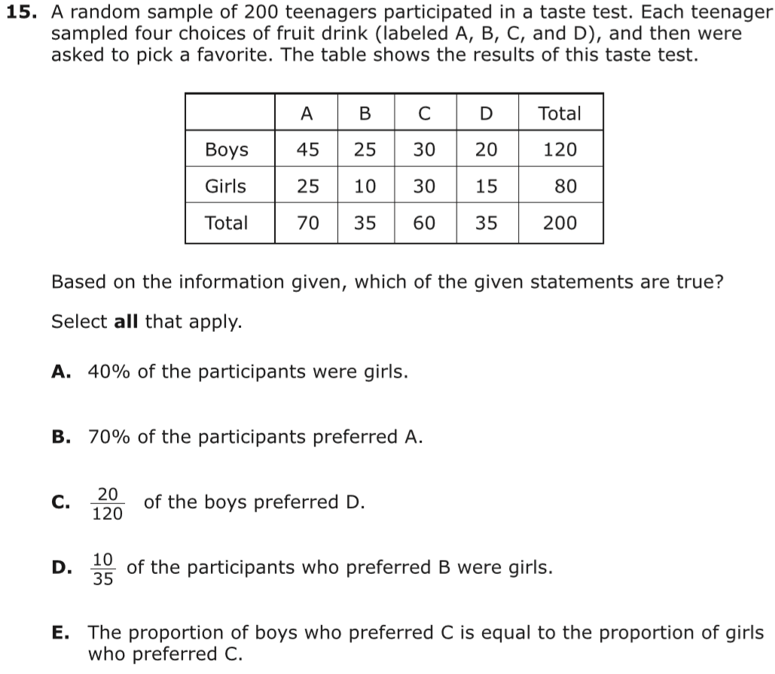
High School
Procedural | Conceptual | Application
1 | 0 | 1
In this Algebra 1 application item the mathematics is directly indicated. The procedures are below grade level.
This item is from the from the PARCC Algebra 1 Practice Test, p.26.

Slide 22
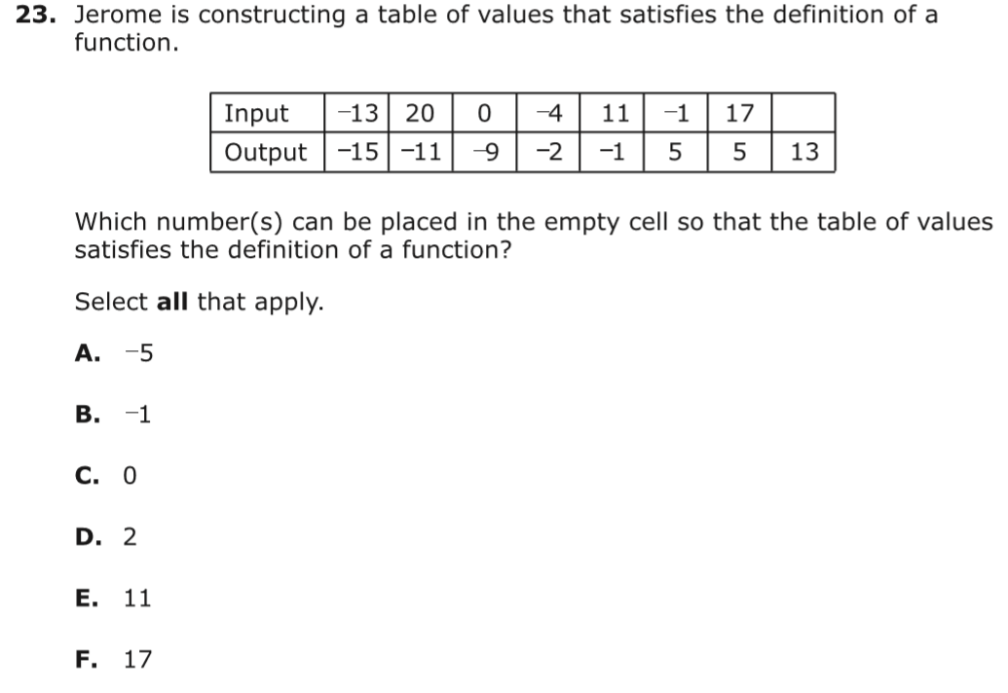
High School
Procedural | Conceptual | Application
0 | 1 | 0
In this Algebra 1 task students need only recall and use the definition of function.
This item is from the from the PARCC Algebra 1 Practice Test, p.32.

Slide 23
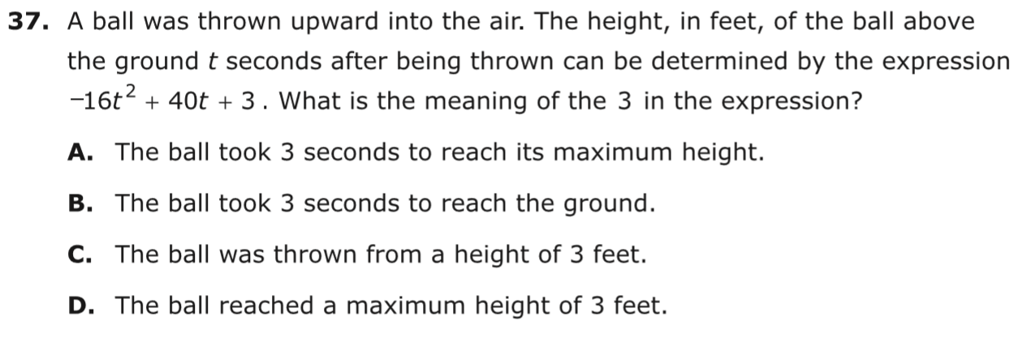
High School
Procedural | Conceptual | Application
0 | 1 | 2
This Algebra 1 item requires an interpretation of the context to determine the meaning of the constant term.
This item is from the from the PARCC Algebra 1 Practice Test, p.49.

Slide 24
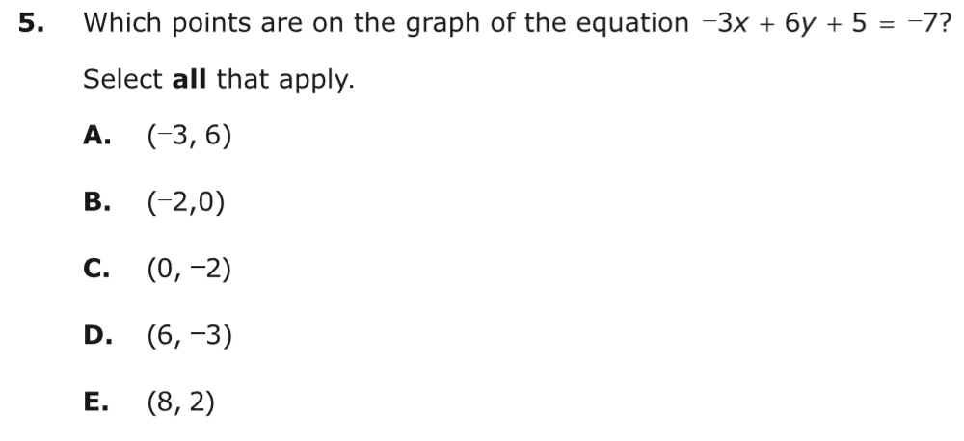
High School
Procedural | Conceptual | Application
1 | 1 | 0
In this Algebra I item the procedure (substitution) is below grade level. The concept (points that make the equation true lie on the graph) is grade level, but students do not need to relate concepts or demonstrate a line of reasoning.
This item is from the from the PARCC Algebra 1 Practice Test, p.9.

Slide 25
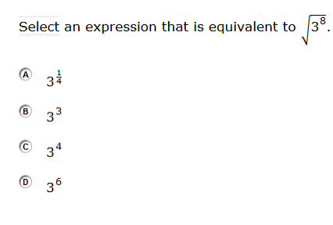
High School
Procedural | Conceptual | Application
2 | 0 | 0
This high-school level task is procedural and at grade level. High school students are expected to rewrite expressions involving radicals and rational exponents.
This item is from the Smarter Balanced Assessment Consortium: Mathematics Practice Test Scoring Guide High School, 08/01/2016, p. 4.

Slide 26
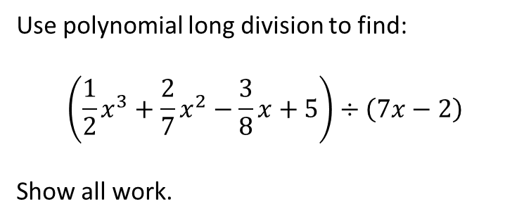
High School
Procedural | Conceptual | Application
3 | 0 | 0
Use polynomial long division to find:
$$\left(\frac{1}{2}x^{3}+\frac{2}{7}x^{2}−\frac{3}{8}x+5\right)÷\left(7x−2\right)$$
Show all work.
In this task students have to work with unfriendly numbers. A student may know the procedure very well, yet get an incorrect answer due to the numbers involved. The task also requires unusual perseverance.

Slide 27
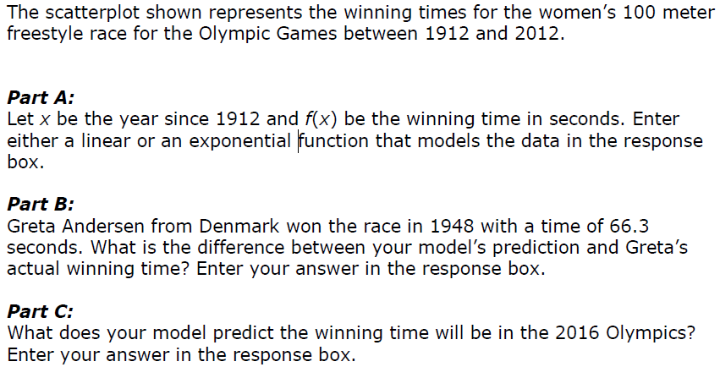
High School
Procedural | Conceptual | Application
2 | 1 | 3
In this high school task students are required to recognize and construct a model, compute the difference between predicted and actual values based on the data and make a prediction by interpreting the model in the context of the situation. The procedure of fitting a curve to a data set is at grade level.
This item is from the Smarter Balanced Math Specifications, High School, Claim 4, p. 35).

