Slide 1
A model for final exam review
January 24, 2019

Slide 2
https://tedcoe.com/math/ade19

Slide 3
What does proficiency mean in your classes?

Slide 4
Ideally:
Standards
Curriculum
Instruction
Materials
Assessment

Slide 5
Standards?
Standards
Curriculum
Instruction
Materials
Assessment
Play the central role.

Slide 6
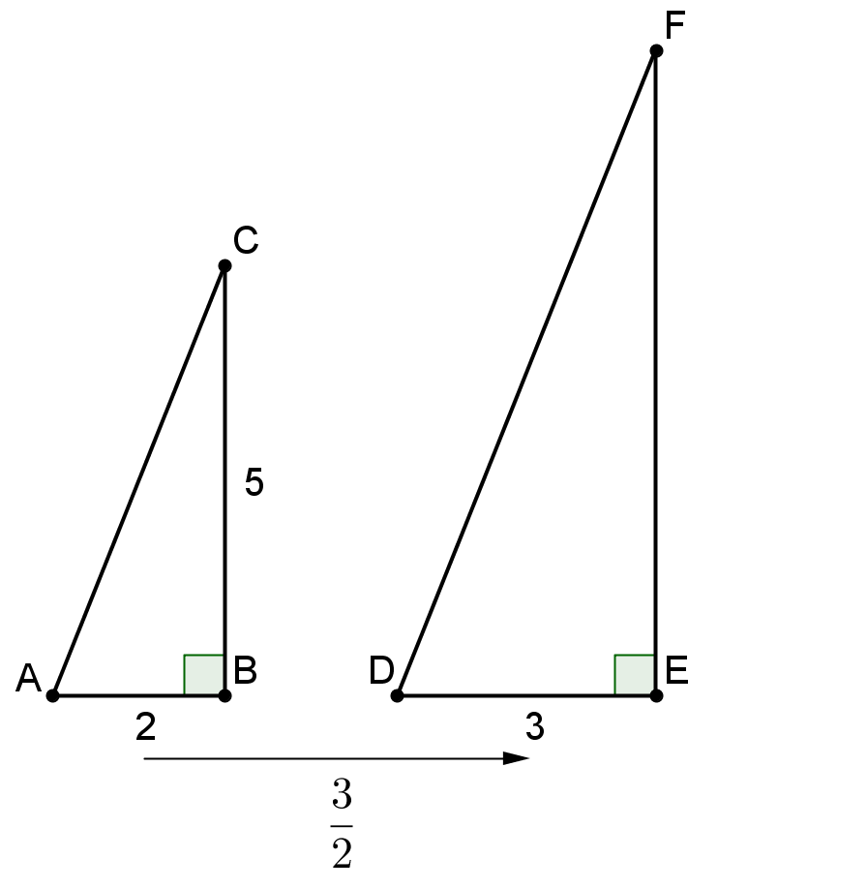
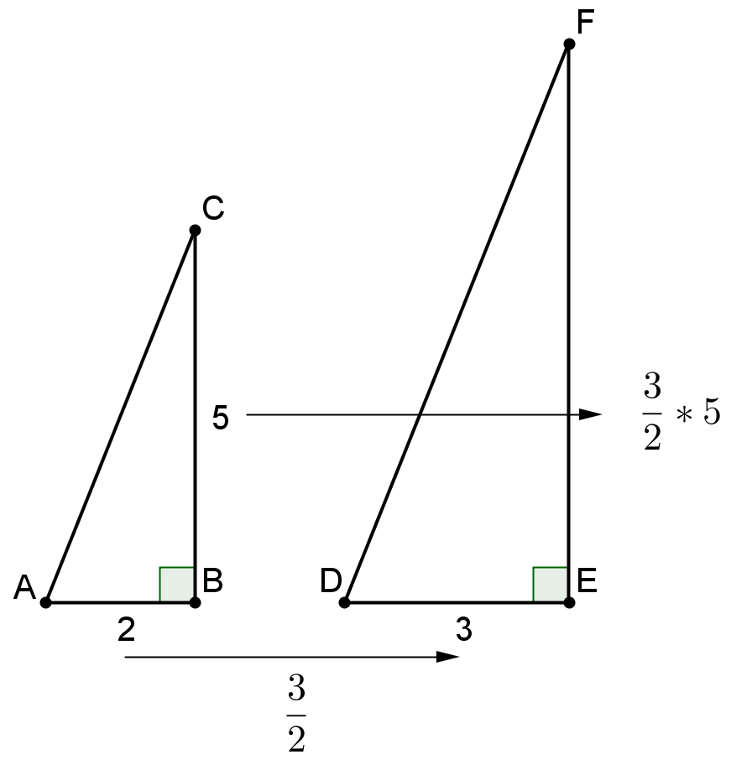
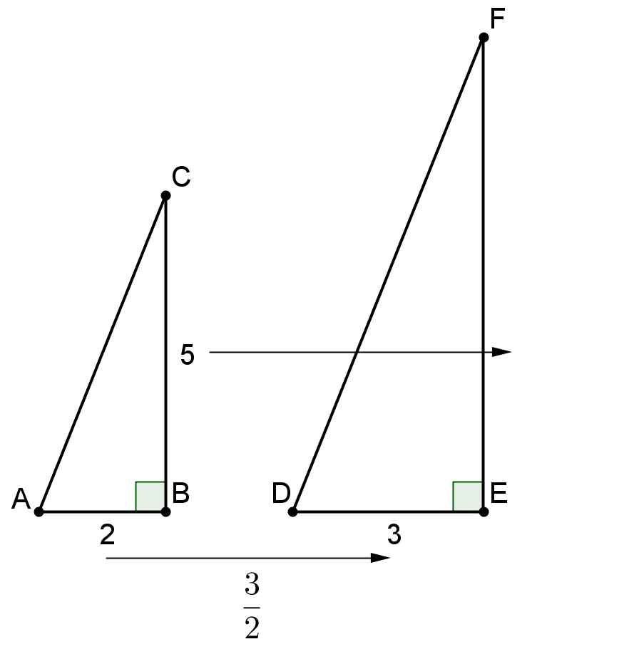
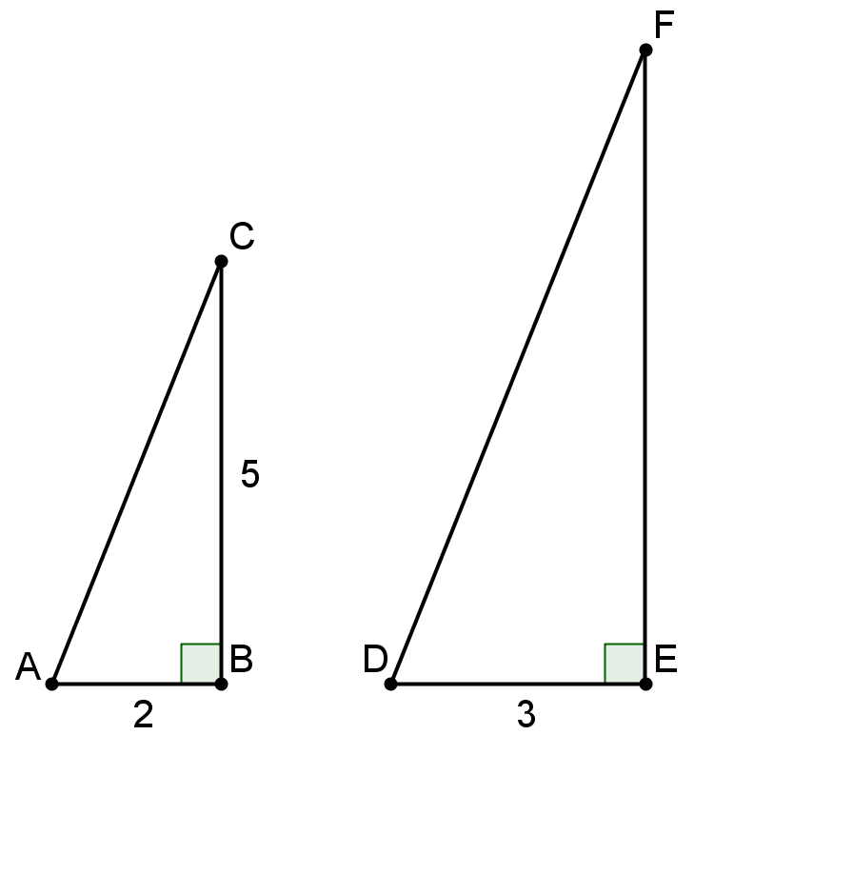

Slide 7
AZ Mathematics Standards 8.EE.6
AZ: 8.EE.B.6: Use similar triangles to explain why the slope m is the same between any two distinct points on a non-vertical line in the coordinate plane. Derive the equation y = mx for a line through the origin and the equation y = mx + b for a line intercepting the vertical axis at (0, b).
Arizona Mathematics Standards 8th Grade (December, 2016)

Slide 8
Similar Triangles

Slide 9
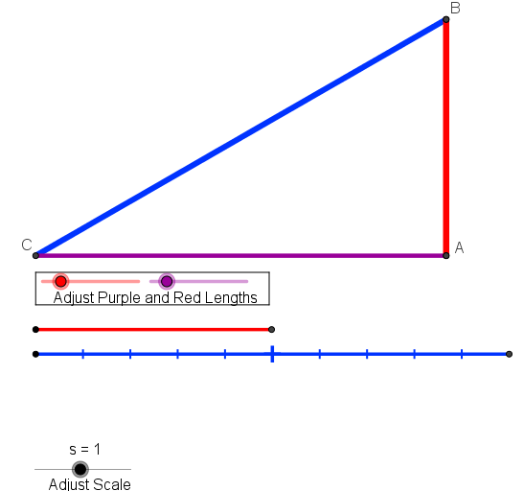
Similar Triangles

Slide 10
Constant Rate

Slide 11
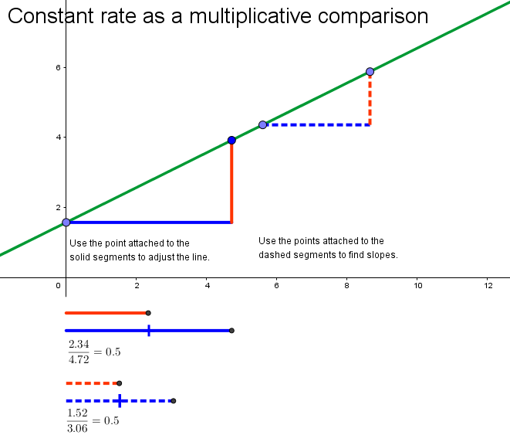
Constant Rate

Slide 12
Linear Equations

Slide 13
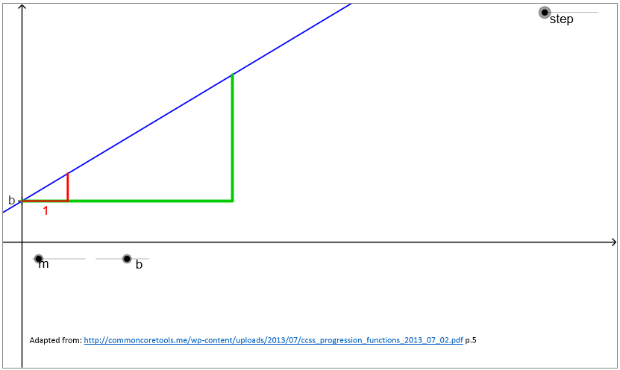
Linear Equations

Slide 14
AZ Mathematics Standards 8.EE.6
AZ: 8.EE.B.6: Use similar triangles to explain why the slope m is the same between any two distinct points on a non-vertical line in the coordinate plane. Derive the equation y = mx for a line through the origin and the equation y = mx + b for a line intercepting the vertical axis at (0, b).
Arizona Mathematics Standards 8th Grade (December, 2016)

Slide 15
Standards
Study the standards, particularly those in Grades 6-8.
Study the progressions documents. http://math.arizona.edu/~ime/progressions/

Slide 16
The Shifts What makes college- and career-ready standards different?
Focus strongly where the standards focus.
Coherence: Think across grades and link to major topics within grades.
Rigor: In major topics, pursue conceptual understanding, procedural skill and fluency, and application with equal intensity.
From Student Achievement Partners

Slide 17
Standards
Curriculum
Instruction
Materials
Assessment

Slide 18
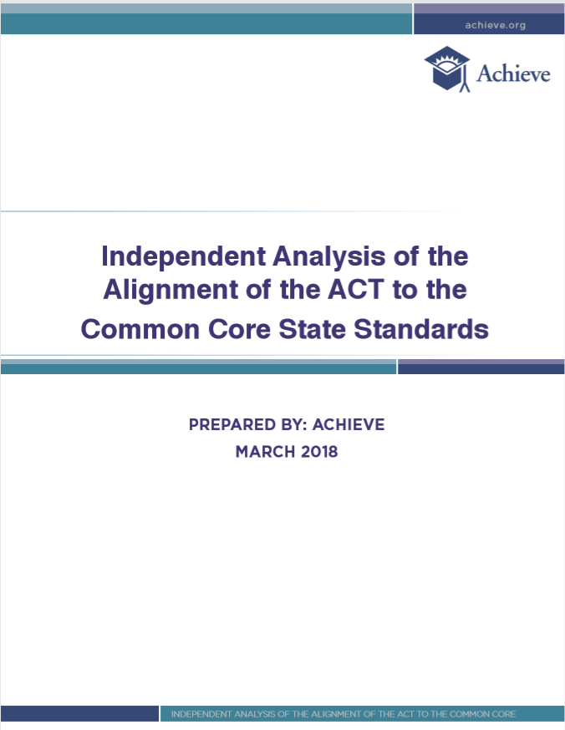
Assessment?

Slide 19
Assessment Criteria
Test Content Criteria:
C.1: Focusing strongly on the content most needed for success in later mathematics
C.2: Assessing a balance of concepts, procedures, and applications
Test Depth Criteria:
C.3: Connecting practice to content
C.4: Requiring a range of cognitive demand
C.5: Ensuring high-quality items and a variety of item types

Slide 20
Assessment Criteria
Test Content Criteria:
C.1: Focusing strongly on the content most needed for success in later mathematics
C.2: Assessing a balance of concepts, procedures, and applications
Test Depth Criteria:
C.3: Connecting practice to content
C.4: Requiring a range of cognitive demand
C.5: Ensuring high-quality items and a variety of item types

Slide 21
C.1: Focusing strongly on the content most needed for success in later mathematics
Look for items aligned to the major work of the grade/widely applicable prerequistes.
Targets:
75% for Grades 3-5 (by design and observed)
67% for Grades 6-8
50% for High School
Blueprints connect to progressions

Slide 22
Blueprints
https://cms.azed.gov/home/GetDocumentFile?id=586fb20caadebe0438509298

Slide 23
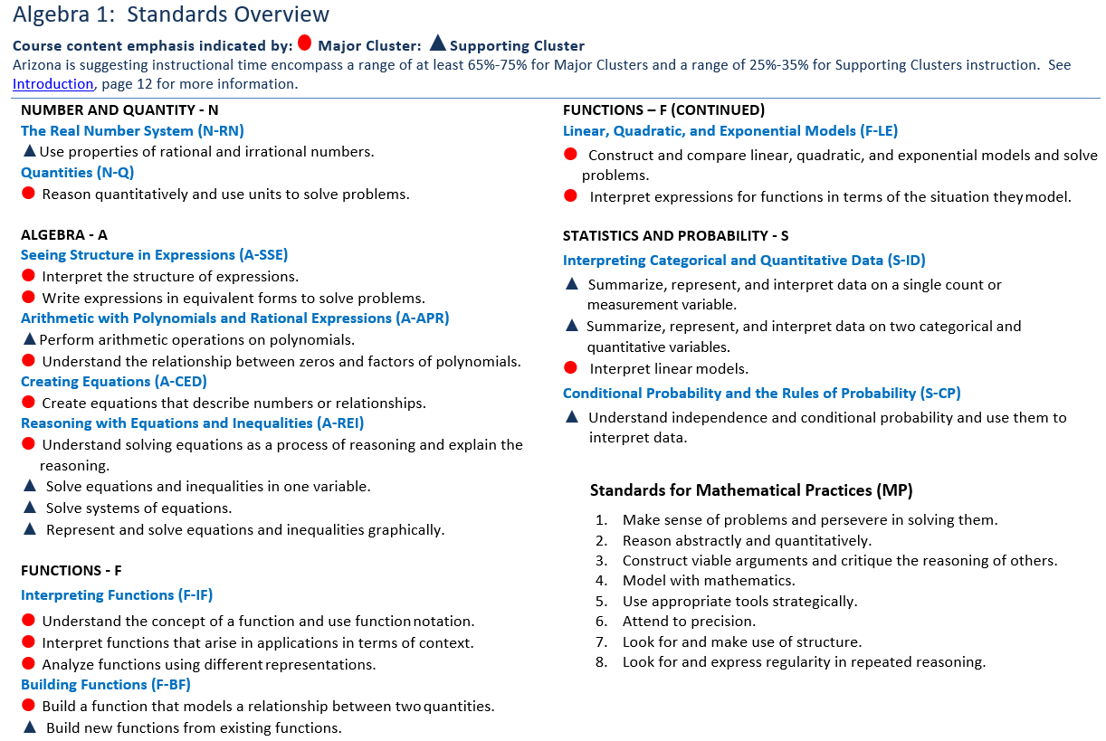
AZ Standards

Slide 24
C.2: Assessing a balance of concepts, procedures, and applications
Look for a balance of conceptual understanding, fluency and procedural skills, and application in the items.

Slide 25
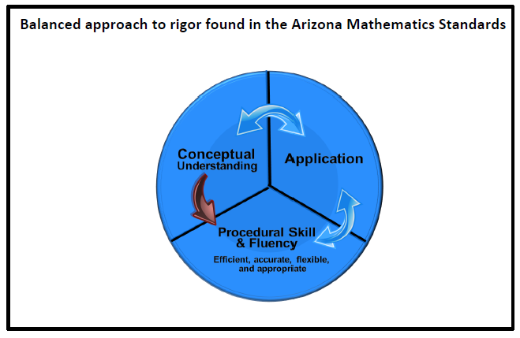
From the Arizona Mathematics Standards (p.2)

Slide 26
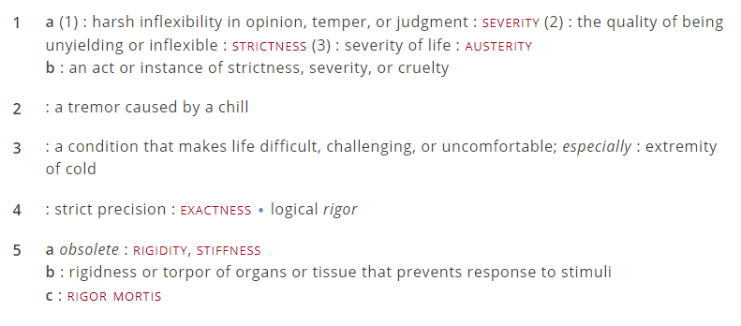
Definition
https://www.merriam-webster.com/dictionary/rigor

Slide 27
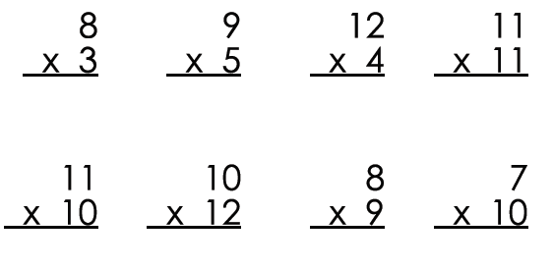

Slide 28
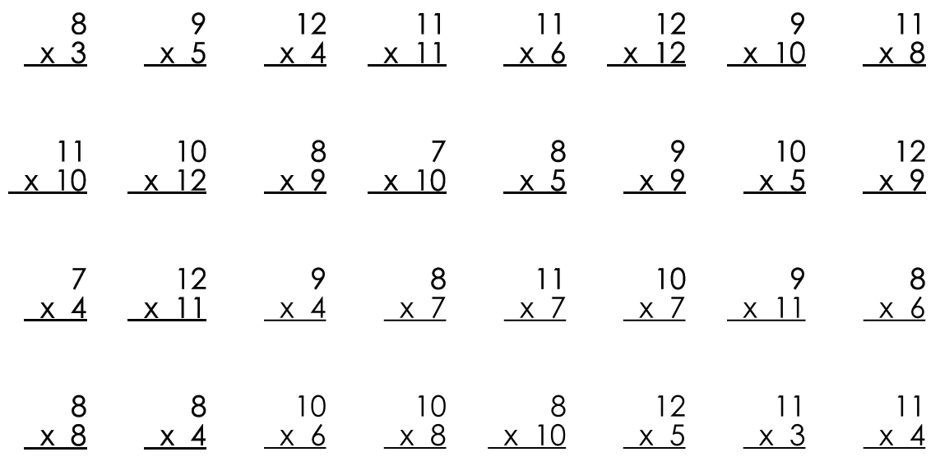

Slide 29
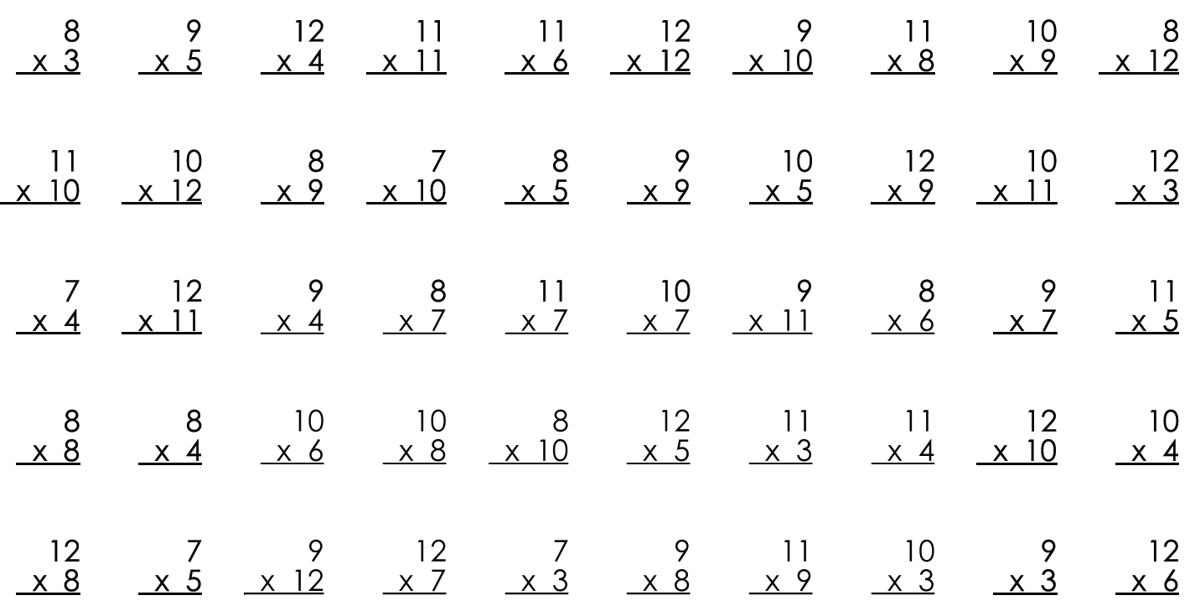

Slide 33
Fordham Institute, 2016
Doorey, N., & Polikoff, M. (2016). Evaluating the content and quality of next generation assessments. Thomas B. Fordham Institute. https://edexcellence.net/publications/evaluating-the-content-and-quality-of-next-generation-assessments. p. 18.

Slide 34
The Aspects of Rigor (AOR) Matrix
 | The item does not involve application. | The item involves an application.
The item targets procedural skill expected by the grade level. | P | P-A
The item targets conceptual understanding and procedural skill expected by the grade level OR targets conceptual understanding but can also be answered using at least some procedural skill expected by the grade level. | P-C | P-C-A
The item targets conceptual understanding. Students may explain, strategize, evaluate, determine, compare, or classify. | C | C-A
A procedure is a step-by-step sequence that can be memorized and executed without understanding or attending to the meaning of the quantities; a procedure is useful for a class of problems or situations. Computations that are likely to be known from memory are considered procedural.
Conceptual understanding refers to the mathematics used to respond to an item, not the complexity of the question itself.
Names or mathematical referents (e.g., units of measure) may be present in item, but should not be considered application in the sense intended by the shifts in CCR standards.

Slide 35
This item is coded as P. By the end of grade 6, multi-digit division can be done by carrying out a known set of steps.

Slide 36
This item is coded as C. The question asks students to represent fractions on a number line diagram which requires a strong understanding of fractions as numbers, including the meaning of the numerator and denominator and how that relates to the way the number line partitioned.

Slide 37
This item is coded as P-A. The item resembles a standard application of mathematics in the real world, computing total cost based on a unit rate. Students use procedural skill to compute the total cost.

Slide 38
Identifying Concepts, Procedures, and Applications
It’s a conceptual understanding item if…
It assesses a mathematical concept
It rewards understanding of a targeted concept over brute force skill.
It’s a procedural skill and/or fluency item if…
Students use a known, step-by-step process to solve the item
Students can solve from memory
It’s an application item if…
There is a real-life, non-trivial context
Notes:
These statements may come in handy as you review problems in our first activity for a balance of concepts, procedures and application.
handout

Slide 39
C.2: Assessing a balance of concepts, procedures, and applications
 | No Application | Application
Procedural | 15-35%
Procedural/Conceptual | 25-50% | 25-50%
Conceptual

Slide 40
C.3: Connecting practice to content
Look for the mathematical practices reflected in the items.
Targets:
At least 1/3 of the items reflect the practices with 95% of those aligning to content standards.

Slide 41
C.4: Requiring a range of cognitive demand
Look for depth and complexity in the items

Slide 42
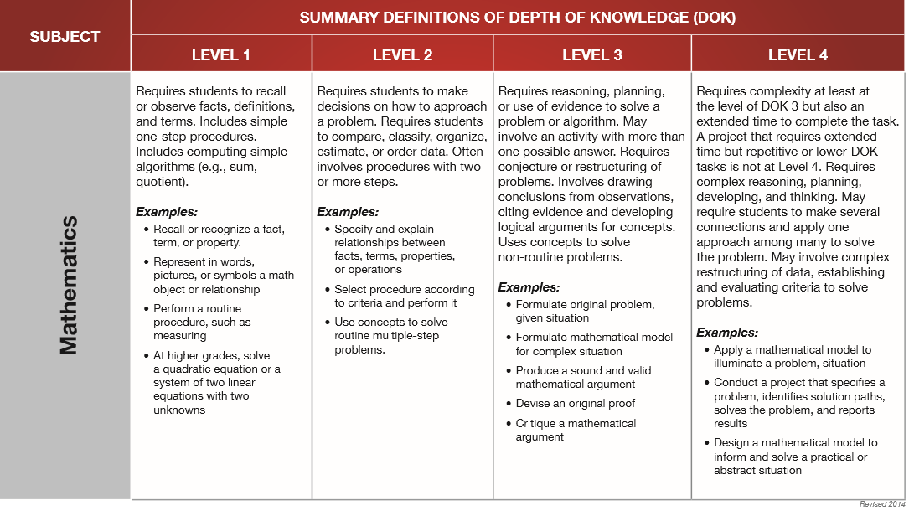
Depth of Knowledge
http://www.webbalign.org/Webbs-DOK-Levels-Summary.pdf

Slide 43
So we tried to do just that…
 | The item does not involve application. | The item involves an application.
The item targets procedural skill expected by the grade level. | P | P-A
The item targets conceptual understanding and procedural skill expected by the grade level OR targets conceptual understanding but can also be answered using at least some procedural skill expected by the grade level. | P-C | P-C-A
The item targets conceptual understanding. Students may explain, strategize, evaluate, determine, compare, or classify. | C | C-A
How can we talk about procedural, conceptual, and application complexity?

Slide 44
Procedural Complexity
 | Level 1 | Level 2 | Level 3
Procedural Complexity:¹ | Solving the problem entails little procedural demand or procedural demand² is below grade level. | Solving the problem entails common or grade-level procedure(s) with friendly numbers. | Solving the problem requires common or grade-level procedure(s) with unfriendly numbers,³ an unconventional combination of procedures, or requires unusual perseverance or organizational skills in the execution of the procedure(s).
^{[1]} This is based on the NAEP States Item to Item Comparison Study, NAEP Validity Studies Panel; Philip Daro, Gerunda Hughes, Sami Kamito, Fran Stancavage, Natalie Tucker-Bradway; American Institutes for Research, 2018.
^{[2]} A procedure is a step by step sequence that can be memorized and executed without understanding or attending to the meaning of the quantities; a procedure is useful for a class of problems or situations. Computations that are likely to be known from memory are considered procedural.
^{[3]} Unfriendly numbers: The student is likely to get the problem wrong not because of the targeted procedure but because of the numbers involved.

Slide 45
Conceptual Complexity
 | Level 1 | Level 2 | Level 3
Conceptual Complexity:¹ | Solving the problem requires students to recall or recognize a grade-level concept. The student does not need to relate concepts or demonstrate a line of reasoning. | Students may need to relate multiple grade-level concepts of different types, create multiple representations or solutions, or connect concepts with procedures or strategies. The student must do some reasoning, but may not need to demonstrate a line of reasoning. | Solving the problem requires students to relate multiple grade-level concepts and to evidence reasoning, planning, analysis, judgment, and/or creative thought OR work with a sophisticated (nontypical) line of reasoning.
^{[4]} This is based on the conceptual aspects of the Mathematics Framework for the 2015 National Assessment of Educational Progress; National Assessment Governing Board, 2014.

Slide 46
Application Complexity
 | Level 1 | Level 2 | Level 3
Application Complexity: | Solving the problem entails an application of mathematics, but the required mathematics is either directly indicated or obvious. | Solving the problem entails an application of mathematics and requires an interpretation of the context to determine the procedure or concept (may include extraneous information). The mathematics is not immediately obvious. Solving the problem requires students to decide what to do. | In addition to an interpretation of the context, solving the problem requires recognizing important features, and formulating, computing, and interpreting results as part of a modeling process.

Slide 47
 | Level 1 | Level 2 | Level 3
Procedural Complexity: | Solving the problem entails little procedural demand or procedural demand is below grade level. | Solving the problem entails common or grade-level procedure(s) with friendly numbers. | Solving the problem requires common or grade-level procedure(s) with unfriendly numbers, an unconventional combination of procedures, or requires unusual perseverance or organizational skills in the execution of the procedure(s).
Application Complexity: | Solving the problem entails an application of mathematics, but the required mathematics is either directly indicated or obvious. | Solving the problem entails an application of mathematics and requires an interpretation of the context to determine the procedure or concept (may include extraneous information). The mathematics is not immediately obvious. Solving the problem requires students to decide what to do. | In addition to an interpretation of the context, solving the problem requires recognizing important features, and formulating, computing, and interpreting results as part of a modeling process.
Conceptual Complexity: | Solving the problem requires students to recall or recognize a grade-level concept. The student does not need to relate concepts or demonstrate a line of reasoning. | Students may need to relate multiple grade-level concepts of different types, create multiple representations or solutions, or connect concepts with procedures or strategies. The student must do some reasoning, but may not need to demonstrate a line of reasoning. | Solving the problem requires students to relate multiple grade-level concepts and to evidence reasoning, planning, analysis, judgment, and/or creative thought OR work with a sophisticated (nontypical) line of reasoning.

Slide 48
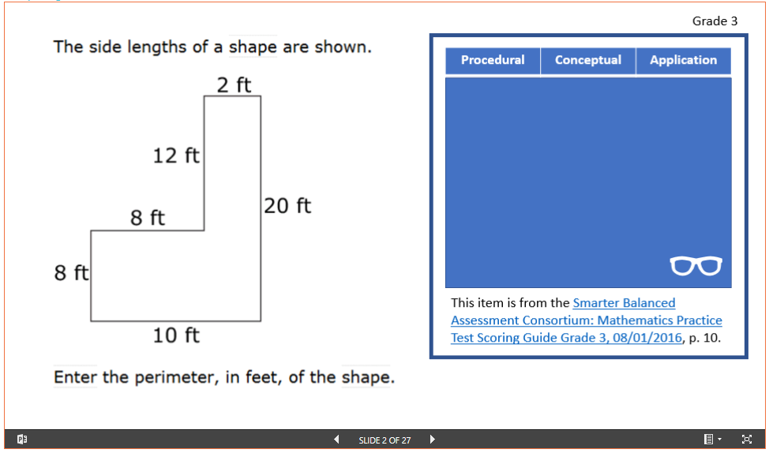
Activity:
http://tedcoe.com/math/ade19
Scroll down to “Sample Rigor Tasks”
Select a grade band
Try an item on your own, then discuss, then click the glasses to see what we selected.
Try a few more items

Slide 49
Additional Guidelines (draft)
Score of zero for procedural if the procedure is more than two grades below level.
If a formula is new to a grade it is procedural level 2.
If a formula is not provided the conceptual score is 1.
If you have to re-read an application problem it may be level 2.
Notes:
With any classification system, the more clearly you can explain each category the higher the reliability of raters -- so making rules about the categories can support this reliability

Slide 50
C.5: Ensuring high-quality items and a variety of item types
Look for alignment to standards, quality (technical/editorial), and item types.
Targets:
90% of items align to standards, 95% free from technical/editorial flaws
Documentation describes alignment and quality processes
At least two item formats are used (by design and observed)

Slide 51
Assessment Criteria
Test Content Criteria:
C.1: Focusing strongly on the content most needed for success in later mathematics
C.2: Assessing a balance of concepts, procedures, and applications
Test Depth Criteria:
C.3: Connecting practice to content
C.4: Requiring a range of cognitive demand
C.5: Ensuring high-quality items and a variety of item types

Slide 52
Time for a review

Slide 53
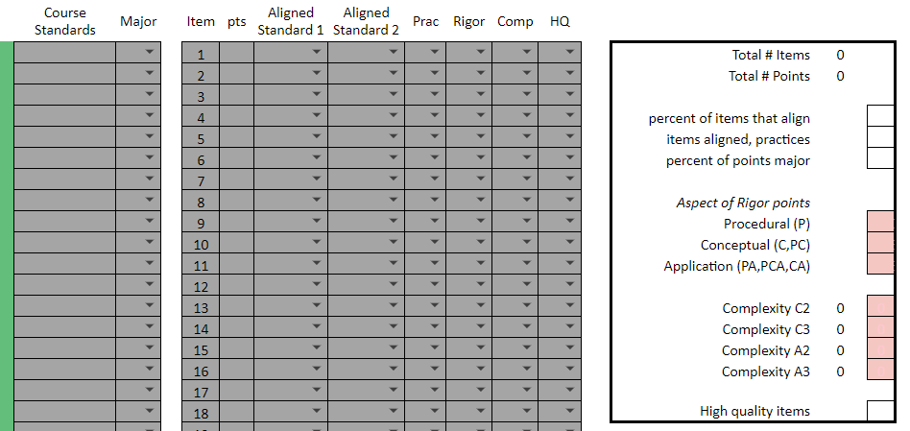
The Spreadsheet (copy here)

Slide 54
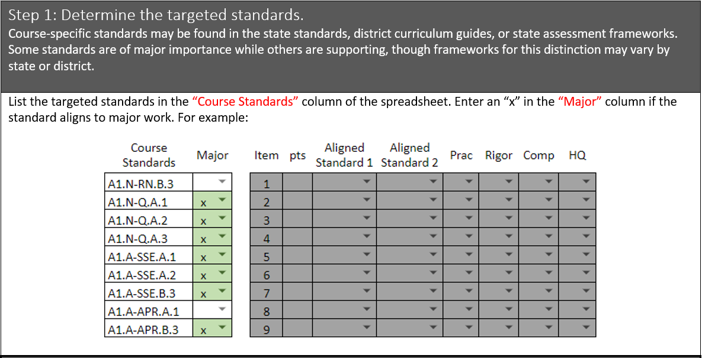

Slide 55
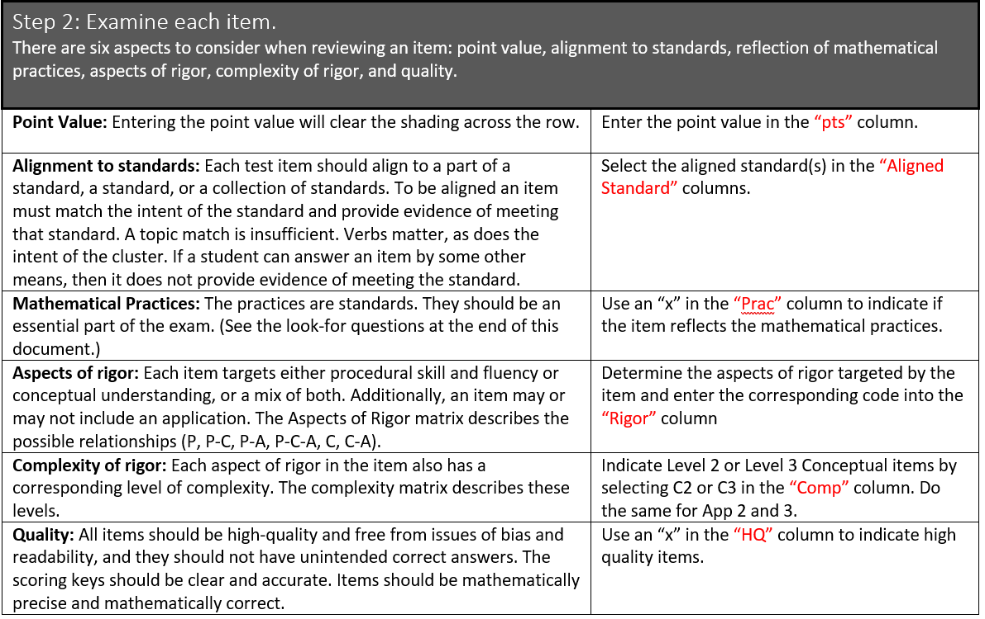

Slide 56
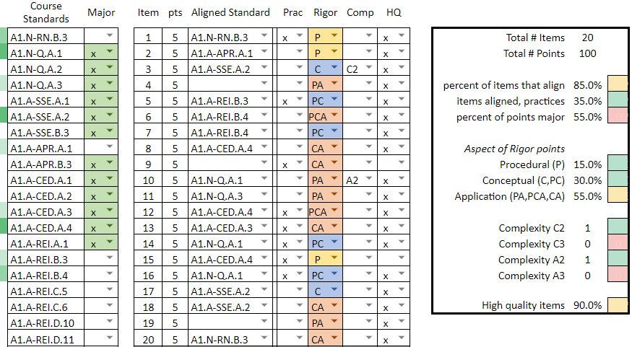

Slide 57
Sample questions to help determine if items reflect the practices: Does the item…
require problem solving by interpreting novel situations without hints or key words?
require the use of meanings of quantities to make sense of problems?
require students to actually construct or critique arguments or develop counterexamples?
require students to identify quantities on their own and enact the modeling process without scaffolds?
give an advantage to the strategic selection of tools?
require students to interpret and use definitions or to communicate with precision?
allow students to more quickly solve a problem when they spot an underlying structure?
require students to formulate a generalization based on repeated reasoning?

Slide 58
Standards
Curriculum
Instruction
Materials
Assessment

Slide 59
What does proficiency mean in your classes?
Do your grades reflect that?

Slide 60
Reminder
Test design should include:
Mathematical Practices
Aspects of rigor
Complexity

Slide 61
Discussion
How can you use this?
How could it be improved?

Slide 62
Do your students habitually think:
Math is a collection of disconnected facts and algorithms
Math is coherent and founded on relationships of ideas.
Math is idiosyncratic and situation specific
Math is logical and systematic
Math is about quick answer-getting
Math is about authentic problem solving
Math is only important for mathematicians
Math is relevant to everyone
Math is to be memorized as given
Math is about constructing knowledge
Heavily Inspired by the taxonomy of the “Views About Mathematics Survey.” For more information see: Carlson, M. P. (1999). The mathematical behavior of six successful mathematics graduate students: Influences leading to mathematical success. Educational Studies in Mathematics, 40(3), 237-258. Only one bullet on this list is not from Carlson.

Slide 63
Do your students habitually think:
Math is for the talented few
Math is available to anyone willing to make the effort.
My effort has no impact on my ability to learn math: I am not a math person.
My achievement depends on my persistence.
Heavily Inspired by the taxonomy of the “Views About Mathematics Survey.” For more information see: Carlson, M. P. (1999). The mathematical behavior of six successful mathematics graduate students: Influences leading to mathematical success. Educational Studies in Mathematics, 40(3), 237-258. Only one bullet on this list is not from Carlson.

