Slide 1
Who Moved My Math?
Issues and Trends in Mathematics Education
Ted Coe, Ph.D.
February 8, 2019

Slide 2
Download this presentation:
http://www.tedcoe.com/math/az19

Slide 3
Question:
How many years was it from December 7, 1941 to December 7, 2014?
How did you figure it out?

Slide 4
What does it mean to say a student is mathematically proficient?

Slide 5
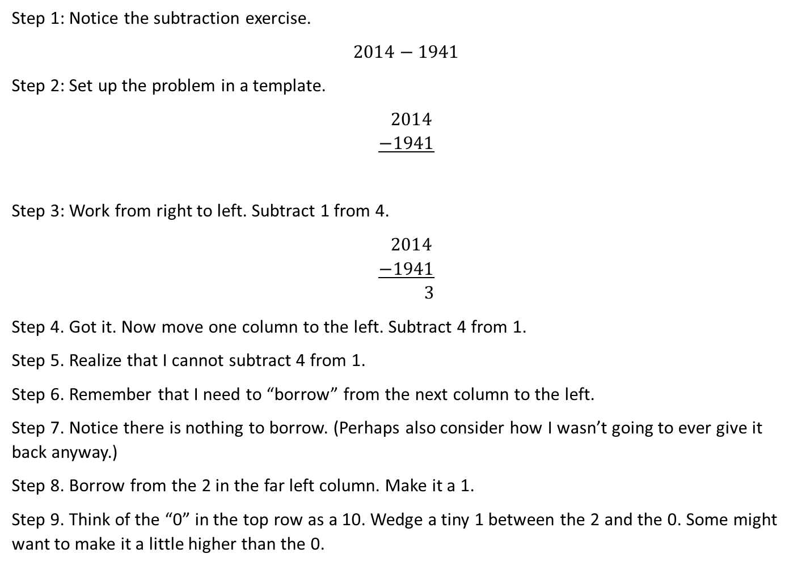
Step 1: Notice the subtraction exercise.
$$2014−1941$$
Step 2: Set up the problem in a template.
$$2014 \\ −1941$$
Step 3: Work from right to left. Subtract 1 from 4.
$$2014 \\ −1941 \\ 3$$
Step 4. Got it. Now move one column to the left. Subtract 4 from 1.
Step 5. Realize that I cannot subtract 4 from 1.
Step 6. Remember that I need to “borrow” from the next column to the left.
Step 7. Notice there is nothing to borrow. (Perhaps also consider how I wasn’t going to ever give it back anyway.)
Step 8. Borrow from the 2 in the far left column. Make it a 1.
Step 9. Think of the “0” in the top row as a 10. Wedge a tiny 1 between the 2 and the 0. Some might want to make it a little higher than the 0.

Slide 6
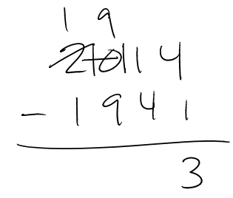
Step 10. Now borrow from the newly made 10. Make it a 9 by crossing out the 0 and 1 you just created during the previous step.
Step 11. Wedge a tiny 1 to the left of the original 1. I now have something that looks like this:
Step 12. Subtract 4 from the newly-made 11. Get 7.
Step 13. Subtract 9 from 9.
Step 14. Subtract 1 from 1.
Step 15. Declare the answer to be 73.

Slide 7
Jordan Ellenberg:
But, too often, we teach our students that “doing mathematics” means “manipulating clusters of digits according to rules presented to us by the teacher.”
That’s not math. And when we teach our students to do that, and only that, we are training them to be slow, buggy versions of Excel. What’s the point?
http://www.slate.com/blogs/how_not_to_be_wrong/2014/06/03/number_sentences_stephen_colbert_thinks_they_re_silly_they_re_not.html

Slide 8
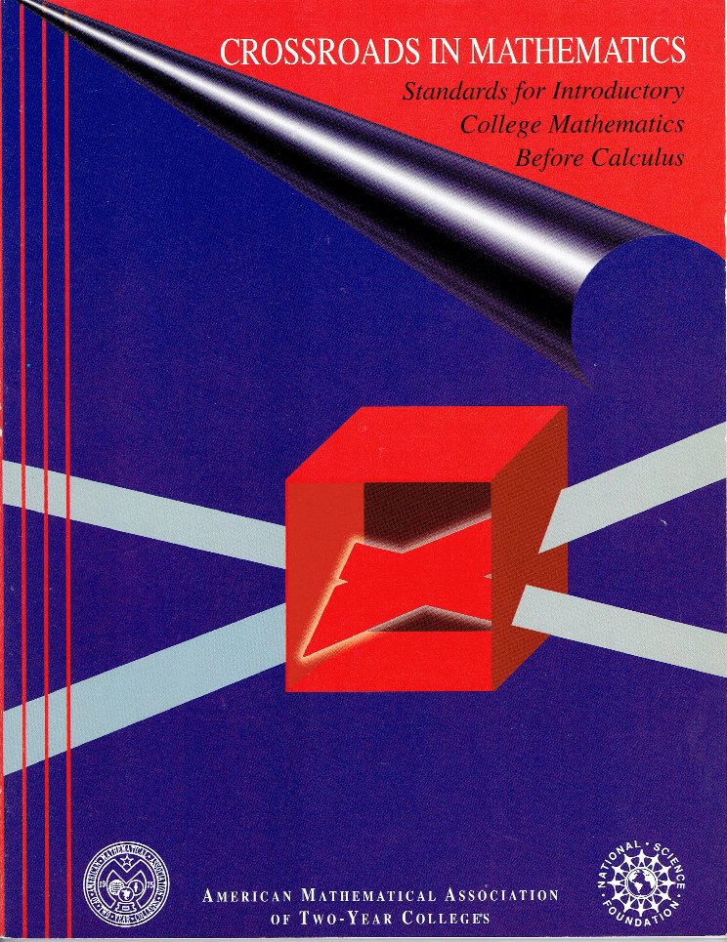
1995
Crossroads?
A need for a well-educated citizenry and workforce, and an incoming student population that was not ready for college-level work.

Slide 9
1995
Standards for Intellectual Development
Standards for Content
Standards for Pedagogy

Slide 10
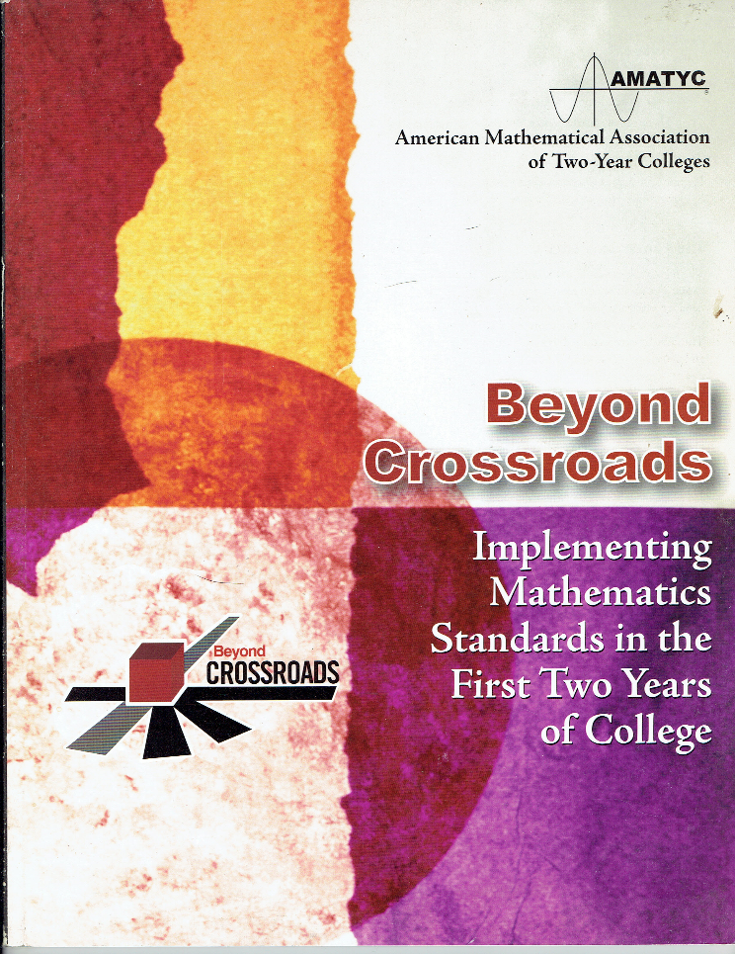
2006
Beyond Crossroads added standards for implementation.

Slide 11
2006
Create an environment that optimizes learning
Ongoing assessment to improve learning
Curriculum and program development -> goals
Use instructional strategies
Ongoing professional development

Slide 12
2018
“The standards set forth in Crossroads in Mathematics and reinforced in Beyond Crossroads were visionary and remain current today.
Nonetheless, there are serious challenges facing mathematics education…”
The world is changing.
American Mathematical Association of Two-Year Colleges. (2018). IMPACT: Improving Mathematical Prowess And College Teaching. Memphis, TN: Author. p.4.

Slide 13
What’s happened since 2006?
iPhone
Tablets
Snapchat, Instagram, Pinterest, Netflix streaming, Hulu, Google Chrome, Spotify, Airbnb, Uber
Consumer Drones
At-home DNA testing
Self-driving cars
Desmos

Slide 14
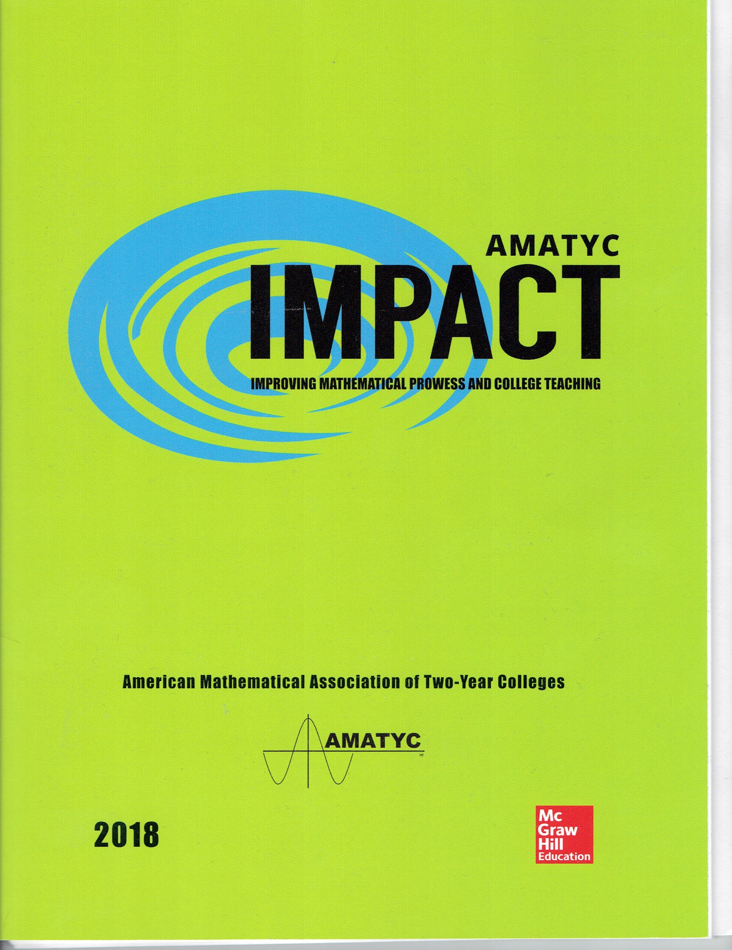
2018

Slide 15
The Need for a Name: IMPACT
Improving Mathematical Prowess and College Teaching
Notes:
Eventually, though, one question arose. What would the new document be called? It seemed awkward to refer to the new work as Beyond, Beyond Crossroads, though that was inarguably accurate. Conversation among the steering committee members led to the realization that we wanted the document to have an impact, and so it was thusly titled. Delightfully, impact, as a word, practically begs to do double-duty as an acronym, as we in education are wont to do. After some debate, IMPACT became Improving Mathematical Prowess and College Teaching.
Prowess was not an immediate hit. It is not a word we typically use in education. It took some time to sink in, but as it can mean expertise or bravery, it seemed a rather wonderful fit. We want both for students and teachers, after all. The real selling point was the realization that prowess, also, could serve as an acronym for the direction we were heading in the new work. Prowess reminds us to think about PRoficiency, OWnership, Engagement, and Student Success. While nested acronyms are not for the faint of heart, the steering committee never lacked confidence that the audience for AMATYC’s IMPACT could not handle it.

Slide 16
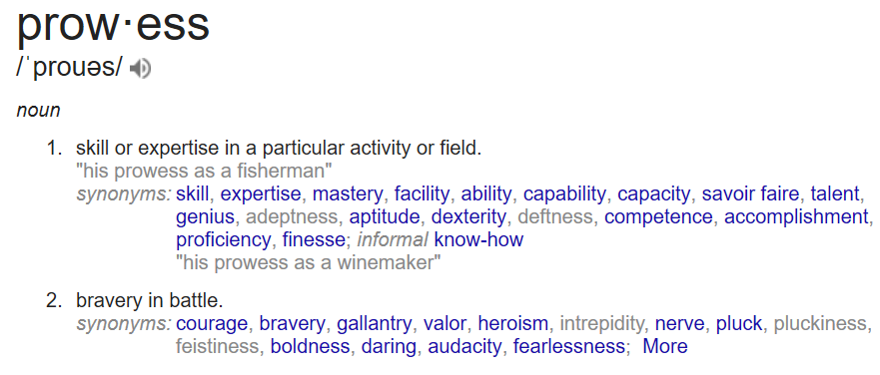
PROWESS?
PRoficiency
OWnership
Engagement
Student Success
Source: Google search for “prowess”

Slide 17
So, what’s new?
 | Content | Practices
K-12
Higher Education

Slide 18
So, what’s new?
 | Content | Practices
K-12
Higher Education
✓

Slide 19
Mile Wide, Inch Deep (2002)
“Our intended content is not focused…If you look at U.S. textbooks, you’ll find there is no textbook in the world that has as many topics as our mathematics textbooks, bar none.”
Schmidt, W., Houang, R., & Cogan, L. (2002). A Coherent Curriculum: The case of mathematics. American Educator 26(2), 10-26. https://www.aft.org/sites/default/files/periodicals/curriculum.pdf. P.3.

Slide 20
Mile Wide, Inch Deep (2002)
“Our intended content is highly repetitive. We introduce topics early and then repeat them year after year. To make matters worse, very little depth is added each time the topic is addressed because each year we devote much of the time to reviewing the topic.”
Schmidt, W., Houang, R., & Cogan, L. (2002). A Coherent Curriculum: The case of mathematics. American Educator 26(2), 10-26. https://www.aft.org/sites/default/files/periodicals/curriculum.pdf. P.3.

Slide 21
Mile Wide, Inch Deep (2002)
“Our intended content is incoherent. Math, for example, is really a handful of basic ideas; but in the United States, mathematics standards are long laundry lists of seemingly unrelated, separate topics.”
Schmidt, W., Houang, R., & Cogan, L. (2002). A Coherent Curriculum: The case of mathematics. American Educator 26(2), 10-26. https://www.aft.org/sites/default/files/periodicals/curriculum.pdf. P.3.

Slide 22
“The [Common Core] standards were not so much assembled out of topics as woven out of progressions. “
The Structure is the Standards. Phil Daro, William McCallum, and Jason Zimba, February 16, 2012. http://commoncoretools.me/2012/02/16/the-structure-is-the-standards/

Slide 23
Question:
How many years was it from December 7, 1941 to December 7, 2014?
How did you figure it out?

Slide 24
2.OA
Represent and solve problems involving addition and subtraction.
1. Use addition and subtraction within 100 to solve one- and two-step word problems involving situations of adding to, taking from, putting together, taking apart, and comparing, with unknowns in all positions, e.g., by using drawings and equations with a symbol for the unknown number to represent the problem.
Add and subtract within 20.
2. Fluently add and subtract within 20 using mental strategies. By end of Grade 2, know from memory all sums of two one-digit numbers.
Source: Common Core State Standards Initiative. (2010). Common Core State Standards for Mathematics. Washington, DC: National Governors Association Center for Best Practices and the Council of Chief State School Officers.

Slide 25
3.NBT
2. Fluently add and subtract within 1000 using strategies and algorithms based on place value, properties of operations, and/or the relationship between addition and subtraction.
Source: Common Core State Standards Initiative. (2010). Common Core State Standards for Mathematics. Washington, DC: National Governors Association Center for Best Practices and the Council of Chief State School Officers.

Slide 26
4.NBT
4. Fluently add and subtract multi-digit whole numbers using the standard algorithm.
Source: Common Core State Standards Initiative. (2010). Common Core State Standards for Mathematics. Washington, DC: National Governors Association Center for Best Practices and the Council of Chief State School Officers.

Slide 27
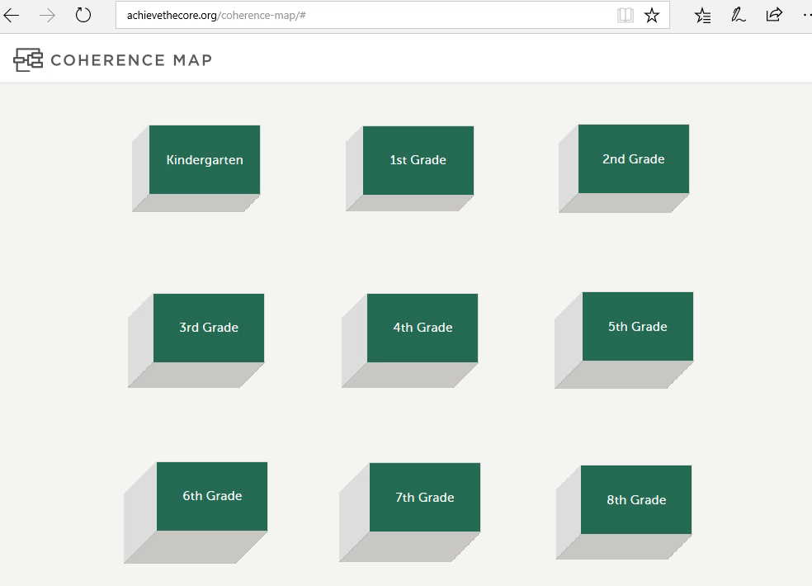

Slide 28
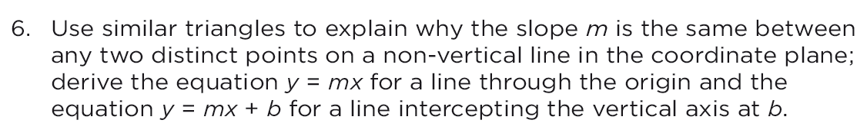
CCSS: Grade 8, 8.EE.6
Source: Common Core State Standards Initiative. (2010). Common Core State Standards for Mathematics. Washington, DC: National Governors Association Center for Best Practices and the Council of Chief State School Officers. P.54

Slide 29
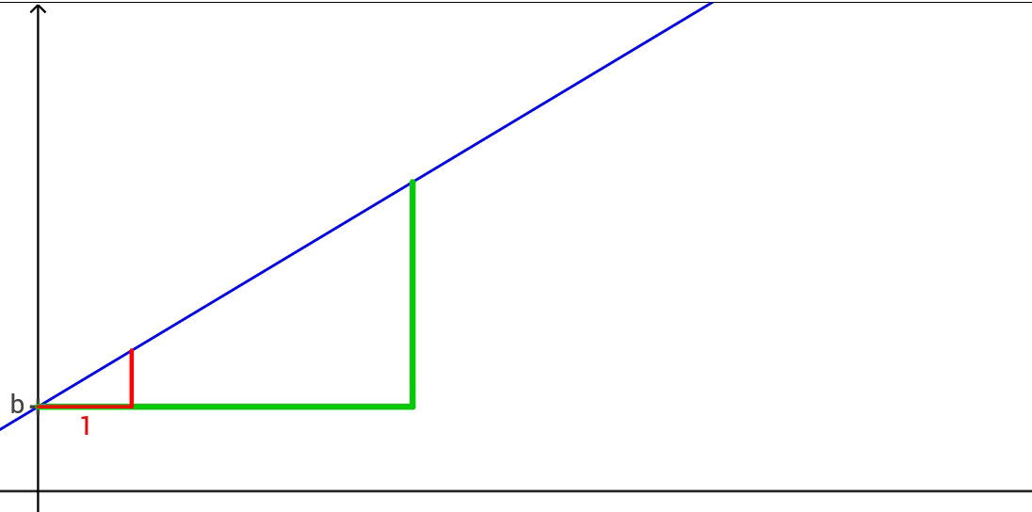
Adapted from: http://commoncoretools.me/wp-content/uploads/2013/07/ccss_progression_functions_2013_07_02.pdf (p.5)

Slide 30
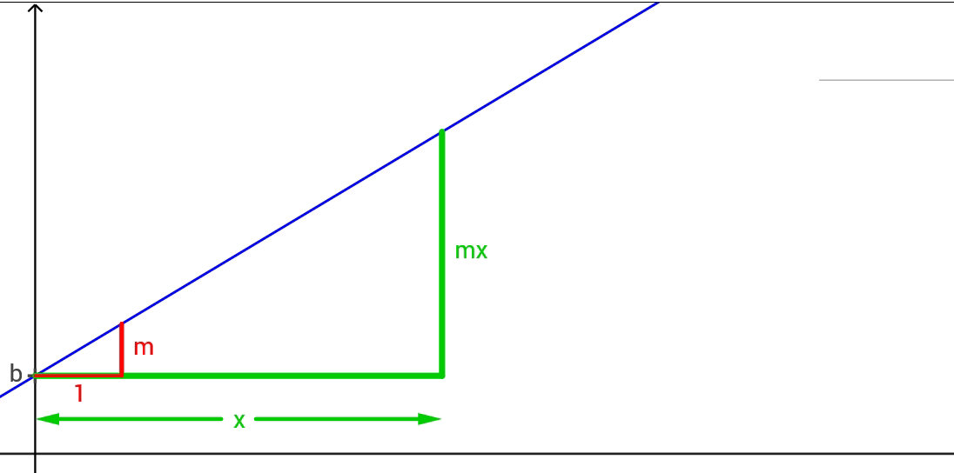
Adapted from: http://commoncoretools.me/wp-content/uploads/2013/07/ccss_progression_functions_2013_07_02.pdf (p.5)

Slide 31
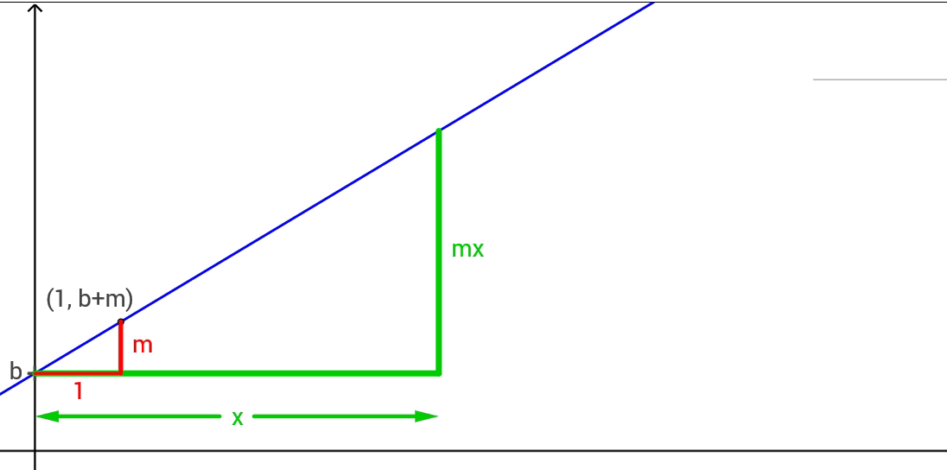
Adapted from: http://commoncoretools.me/wp-content/uploads/2013/07/ccss_progression_functions_2013_07_02.pdf (p.5)

Slide 32
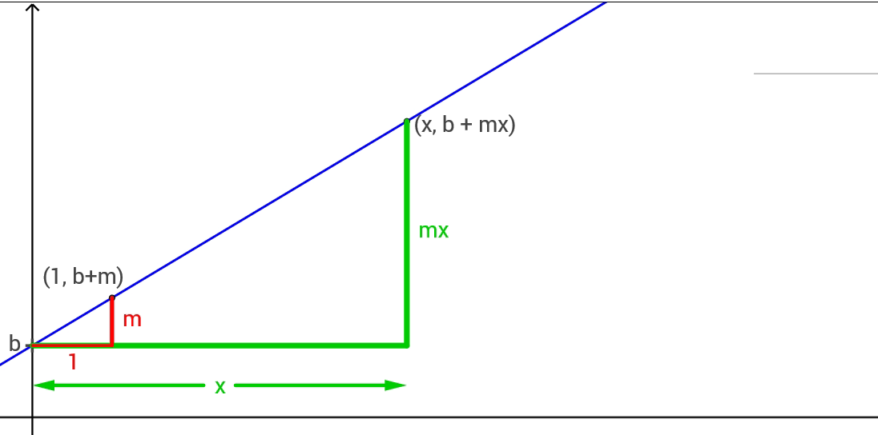
Adapted from: http://commoncoretools.me/wp-content/uploads/2013/07/ccss_progression_functions_2013_07_02.pdf (p.5)

Slide 33
So, what’s new?
 | Content | Practices
K-12
Higher Education
✓
✓

Slide 34
The National Research Council (2013)
“The need to create a truly compelling menu of creatively taught lower-division courses in the mathematical sciences tailored to the needs of twenty-first century students is pressing…”
“Most mathematics departments still tend to use calculus as the gateway to higher-level coursework, and that is not appropriate for many students.”
Student Success.
National Research Council. (2013). The mathematical sciences in 2025. National Academies Press. Pp. 10, Available at https://www.nap.edu/catalog/15269/the-mathematical-sciences-in-2025.
Notes:
Talk about student success

Slide 35
The INGenIOuS Project (MAA, 2014)
“Alternative curricular entry points (e.g., courses other than freshman-level algebra or beginning calculus) and pathways to undergraduate and graduate degrees should be developed.”
Zorn, P., Bailer, J., Braddy, L., Carpenter, J., Jaco, W., & Turner, P. (2014). The INGenIOuS project: Mathematics, statistics, and preparing the 21st century workforce. The Mathematical Association of America. p. 20. http://www.maa.org/sites/default/files/pdf/ingenious/INGenIOuS-report.pdf

Slide 36
A Common Vision (MAA, 2015)
“The current attention to big data and the demand for college graduates with data skills should prompt changes in our entry-level courses ...Thus, there is a call to provide mathematically substantive options for students who are not headed to calculus. These entry courses should focus on problem solving, modeling, statistics, and applications.”
Saxe, K., & Braddy, L. (2015). A Common vision for undergraduate mathematical sciences programs in 2025. The Mathematical Association of America. p. 13. Available at http://www.maa.org/sites/default/files/pdf/CommonVisionFinal.pdf.
Notes:
Amatyc, ams, asa, maa, siam. Reviewed 7 curricular guides.

Slide 37
A Common Vision (MAA, 2015)
“The current attention to big data and the demand for college graduates with data skills should prompt changes in our entry-level courses ...Thus, there is a call to provide mathematically substantive options for students who are not headed to calculus. These entry courses should focus on problem solving, modeling, statistics, and applications.”
Saxe, K., & Braddy, L. (2015). A Common vision for undergraduate mathematical sciences programs in 2025. The Mathematical Association of America. p. 13. Available at http://www.maa.org/sites/default/files/pdf/CommonVisionFinal.pdf.
Notes:
Amatyc, ams, asa, maa, siam. Reviewed 7 curricular guides.

Slide 38
A Common Vision (MAA)
“A primary point emphasized by all the guides is that the status quo is unacceptable.”
Saxe, K., & Braddy, L. (2015). A Common vision for undergraduate mathematical sciences programs in 2025. The Mathematical Association of America. p. 13. Available at http://www.maa.org/sites/default/files/pdf/CommonVisionFinal.pdf.

Slide 39
Transforming Post-Secondary Education in Mathematics (TPSE)
“Institutions must create multiple pathways into and through the mathematical sciences curriculum, offering a mix of choices for math majors as well as other STEM and non-STEM majors and communicating the wide range of math-related career options.”
Transforming Post-Secondary Education in Mathematics: Report of a meeting. TPSE Math (2014) p. 13. Available at http://www.tpsemath.org/meeting1

Slide 40
Transforming Post-Secondary Education in Mathematics (TPSE)
“Increase instruction in use of data, statistics, modeling, and computation. Because this is in line with the Common Core Math Standards, it is particularly important in training future teachers.”
Transforming Post-Secondary Education in Mathematics: Report of a meeting. TPSE Math (2014) p. 13. Available at http://www.tpsemath.org/meeting1

Slide 41
Modernizing Mathematics Pathways at Texas Universities (Dana Center)
“For students majoring in programs such as social or behavioral sciences, the most important mathematics is statistics, not algebra. For liberal arts students, who typically need to take one core math course to graduate in their majors, quantitative reasoning is likely to be more relevant to their future lives and careers.”
Kazis, R. & Cullinane, J. (2015). Modernizing Mathematics Pathways at Texas Universities: Insights from the New Mathways Project Transfer Champions. Austin, TX: The Charles A. Dana Center at The University of Texas at Austin. p.4.

Slide 42
Modernizing Mathematics Pathways at Texas Universities (Dana Center)
“For students majoring in programs such as social or behavioral sciences, the most important mathematics is statistics, not algebra. For liberal arts students, who typically need to take one core math course to graduate in their majors, quantitative reasoning is likely to be more relevant to their future lives and careers.”
Kazis, R. & Cullinane, J. (2015). Modernizing Mathematics Pathways at Texas Universities: Insights from the New Mathways Project Transfer Champions. Austin, TX: The Charles A. Dana Center at The University of Texas at Austin. p.4.

Slide 43
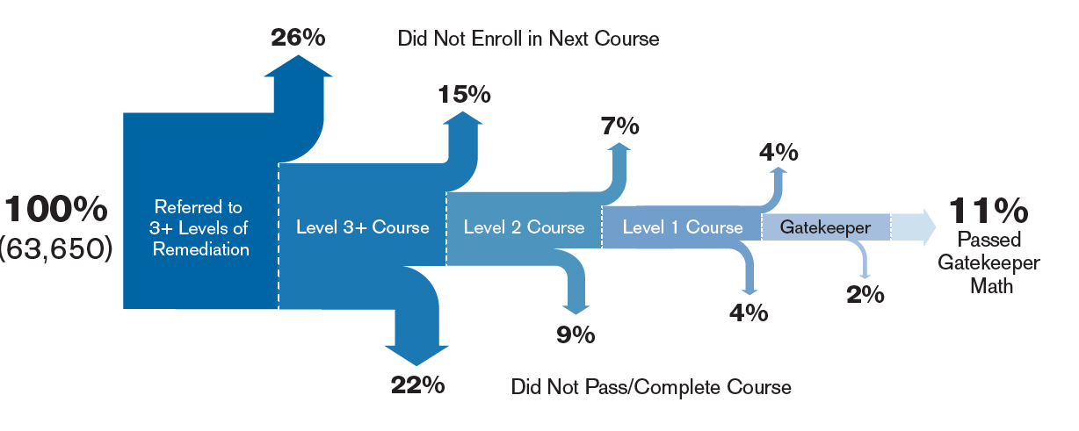
Teachers College, Columbia University (2014)
Jaggars, S. S., & Stacey, G. W. (2014). What We Know about Developmental Education Outcomes. Research Overview. Community College Research Center, Teachers College, Columbia University. P.5, based on 63,650 students.

Slide 44
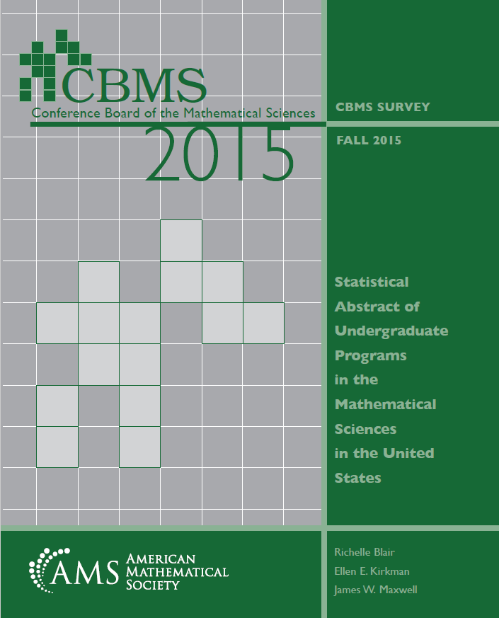
CBMS 2015 Survey
In fall 2015, 58% of two year colleges reported having implemented a pathways sequence
Blair, R., Kirkman, E. E., & Maxwell, J. W. (2018). Statistical abstract of undergraduate programs in the mathematical sciences in the United States: Fall 2015 CBMS survey. Providence, RI: American Mathematical Society. Retrieved from www.ams.org/cbms/cbms-survey

Slide 45
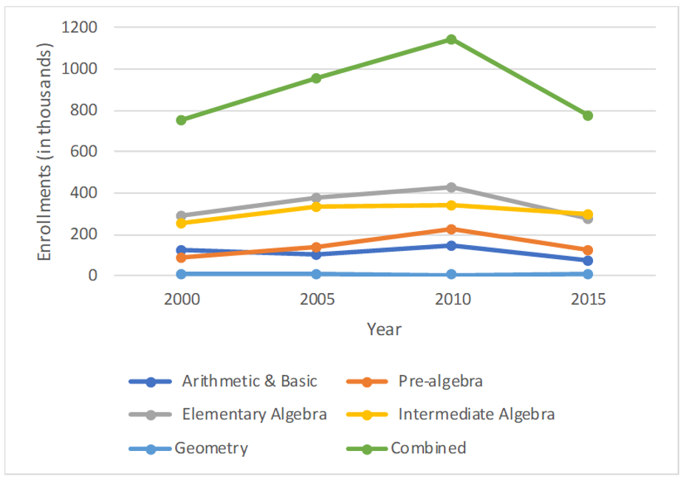
CBMS 2015 Survey
Two-year pre-college level enrollments
Two-year pre-college level enrollments (in thousands, not including Dual Enrollment), in mathematics programs based on Table TYE.3 in the Fall 2015 CBMS Survey.

Slide 46
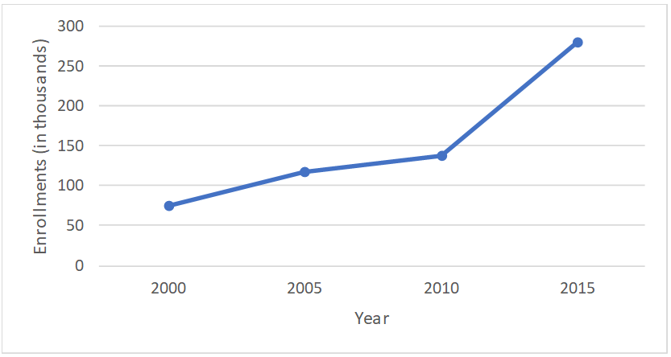
CBMS 2015 Survey
Two-year college Statistics and Probability enrollments.
Based on Table TYE.4 in the Fall 2015 CBMS Survey.

Slide 47
Recent shifts:
AMATYC (2014)
The equivalent content in intermediate algebra courses is not required to master the content for most college-level mathematics courses that do not lead to calculus;
Prerequisite courses other than intermediate algebra can adequately prepare students for courses of study that do not lead to calculus.
https://amatyc.site-ym.com/page/PositionInterAlg

Slide 48
Recent shifts:
AMATYC (2014)
The equivalent content in intermediate algebra courses is not required to master the content for most college-level mathematics courses that do not lead to calculus;
Prerequisite courses other than intermediate algebra can adequately prepare students for courses of study that do not lead to calculus.
https://amatyc.site-ym.com/page/PositionInterAlg

Slide 49
Recent shifts:
Ohio (2015) removed language requiring Intermediate Algebra as the threshold course. They now have Quantitative Reasoning, Statistics and STEM transfer pathways.
Michigan State (2016) dropped the college algebra requirement.
California State University (2017) dropped intermediate algebra as a universal prerequisite.
https://www.ohiohighered.org/sites/ohiohighered.org/files/uploads/math/Memo Announcing Endorsed Changes to the OTM Mathematics Guidelines.pdf
https://www.insidehighered.com/news/2016/07/06/michigan-state-drops-college-algebra-requirement
https://edsource.org/2017/cal-state-drops-intermediate-algebra-requirement-allows-other-math-courses/585595

Slide 50
College Readiness?
What will it mean in 5 years?

Slide 51
So, what’s new?
 | Content | Practices
K-12
Higher Education
✓
✓
✓

Slide 52
Standards for Mathematical Practice
Make sense of problems and persevere in solving them
Reason abstractly and quantitatively
Construct viable arguments and critique the understanding of others
Model with mathematics
Use appropriate tools strategically
Attend to precision
Look for and make use of structure
Look for and express regularity in repeated reasoning
These are essential aspects of being proficient.

Slide 53



The Shifts What makes college- and career-ready standards different?
Focus strongly where the standards focus.
Coherence: Think across grades and link to major topics within grades.
Rigor: In major topics, pursue conceptual understanding, procedural skill and fluency, and application with equal intensity.
Source: Student Achievement Partners

Slide 54
National Mathematics Advisory Panel (2008)
“To prepare students for Algebra, the curriculum must simultaneously develop conceptual understanding, computational fluency, and problem solving skills. Debates regarding the relative importance of these aspects of mathematical knowledge are misguided.”
National Mathematics Advisory Panel. (2008). Foundations for success: The final report of the National Mathematics Advisory Panel. Washington, DC: U.S. Department of Education. https://www2.ed.gov/about/bdscomm/list/mathpanel/report/final-report.pdf.

Slide 55
National Mathematics Advisory Panel (2008)
“To prepare students for Algebra, the curriculum must simultaneously develop conceptual understanding, computational fluency, and problem solving skills. Debates regarding the relative importance of these aspects of mathematical knowledge are misguided.”
National Mathematics Advisory Panel. (2008). Foundations for success: The final report of the National Mathematics Advisory Panel. Washington, DC: U.S. Department of Education. https://www2.ed.gov/about/bdscomm/list/mathpanel/report/final-report.pdf.

Slide 56
Focus
Coherence
Rigor

Slide 57
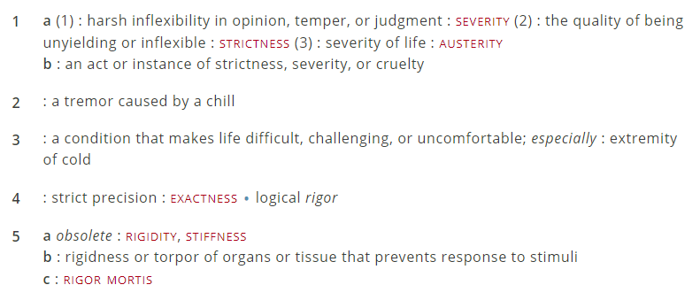
Definition
https://www.merriam-webster.com/dictionary/rigor

Slide 58
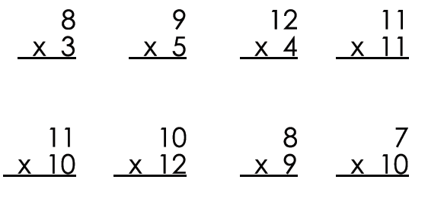

Slide 59
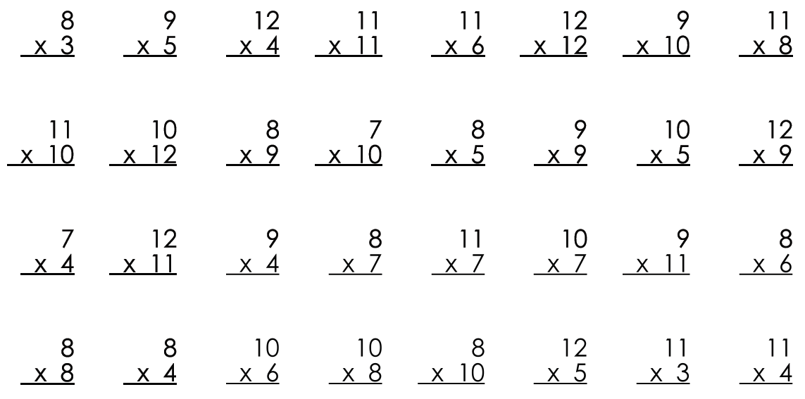

Slide 60
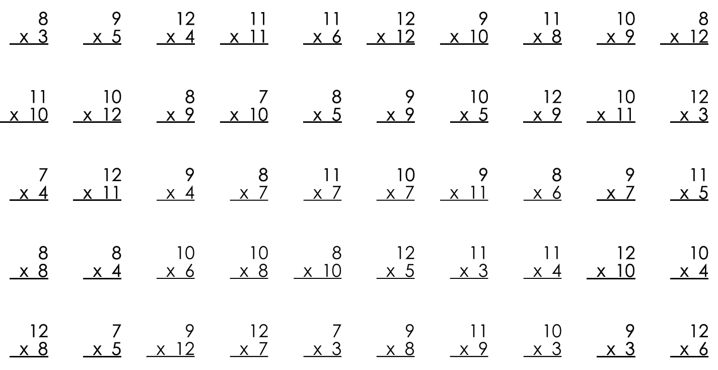

Slide 64
Rigor
Procedural skill and fluency
Conceptual understanding
Application

Slide 65
Aspects of Rigor Matrix
 | The item does not involve application. | The item involves an application.
The item targets procedural skill expected by the grade level. | P | P-A
The item targets conceptual understanding and procedural skill expected by the grade level OR targets conceptual understanding but can also be answered using at least some procedural skill expected by the grade level. | P-C | P-C-A
The item targets conceptual understanding. Students may explain, strategize, evaluate, determine, compare, or classify. | C | C-A
A procedure is a step-by-step sequence that can be memorized and executed without understanding or attending to the meaning of the quantities; a procedure is useful for a class of problems or situations. Computations that are likely to be known from memory are considered procedural.
Conceptual understanding refers to the mathematics used to respond to an item, not the complexity of the question itself.
Names or mathematical referents (e.g., units of measure) may be present in item, but should not be considered application in the sense intended by the shifts in CCR standards.
https://www.achieve.org/mathematics-assessment-cognitive-complexity-framework

Slide 66
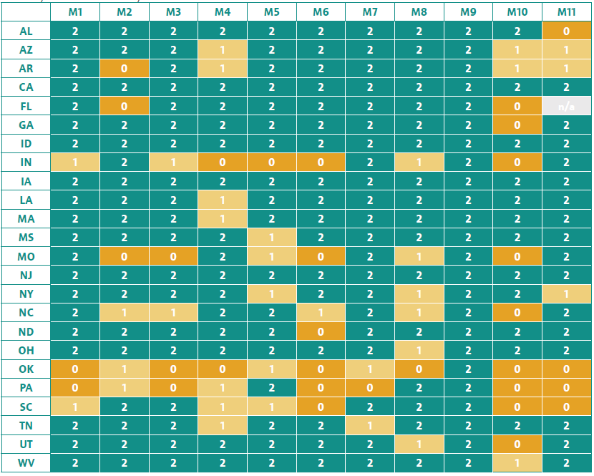
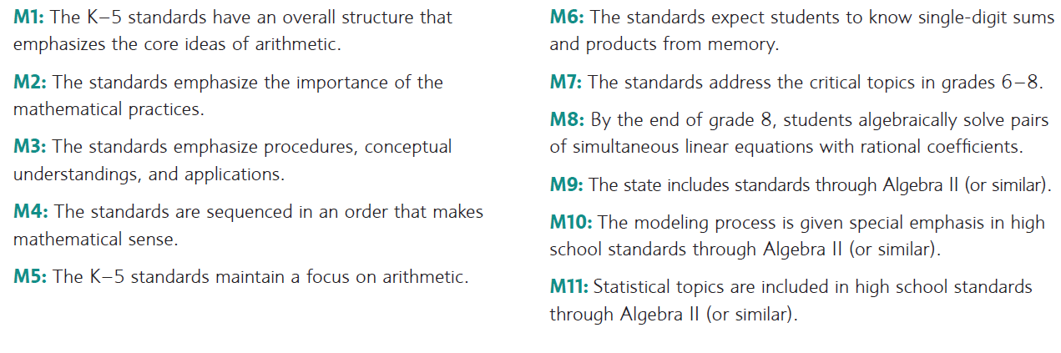
Strong Standards Report
https://www.achieve.org/strong-standards

Slide 67
Ideally:
Standards
Curriculum/ District
Instruction
Materials
Assessment

Slide 68
So, what’s new?
 | Content | Practices
K-12
Higher Education
✓
✓
✓
✓

Slide 69
Engage to Excel (PCAST 2012)
Push for “developing new approaches to remove or reduce the mathematics bottleneck that is currently keeping many students from pursuing STEM majors.”
A national experiment…including… “college mathematics teaching and curricula developed and taught by faculty from mathematics-intensive disciplines other than mathematics, including physics, engineering, and computer science;”
Olson, S., & Riordan, D. G. (2012). Engage to Excel: Producing One Million Additional College Graduates with Degrees in Science, Technology, Engineering, and Mathematics. Report to the President. Executive Office of the President. pp. 29-30

Slide 70
Intersegmental Trust

Slide 71
2015 CUPM Curriculum Guide
Mimicking procedures is not enough. Students must experience for themselves what it means to understand mathematical ideas deeply. They must feel the exhilaration of mathematical insight. They must learn and appreciate productive struggle. They must learn to articulate mathematical ideas clearly, orally and in writing.
http://www.maa.org/sites/default/files/pdf/CUPM/pdf/CUPMguide_print.pdf (pp 62)
Notes:
Higher ed math students

Slide 72
2015 CUPM Curriculum Guide
Like virtually all college faculty, they teach the way they were taught. But, ironically (and embarrassingly),it would be difficult to design an educational model that is more at odds with the findings of current research about human cognition than the one being used today at most colleges and universities
http://www.maa.org/sites/default/files/pdf/CUPM/pdf/CUPMguide_print.pdf (p. 70 quoting Halpern and Hakel (2003))
Notes:
Higher ed math students

Slide 73
Dana Center’s DCMP
Principle 1: All students, regardless of college readiness, enter directly into mathematics pathways aligned to their programs of study.
Principle 2: Students complete their first college-level mathematics requirement in their first year of college.
Principle 3: Strategies to support students as learners are integrated into courses and are aligned across the institution.
Principle 4: Instruction incorporates evidence-based curriculum and pedagogy.
https://dcmathpathways.org/dcmp/dcmp-model

Slide 74
Dana Center’s DCMP
Principle 1: All students, regardless of college readiness, enter directly into mathematics pathways aligned to their programs of study.
Principle 2: Students complete their first college-level mathematics requirement in their first year of college.
Principle 3: Strategies to support students as learners are integrated into courses and are aligned across the institution.
Principle 4: Instruction incorporates evidence-based curriculum and pedagogy.
https://dcmathpathways.org/dcmp/dcmp-model

Slide 75
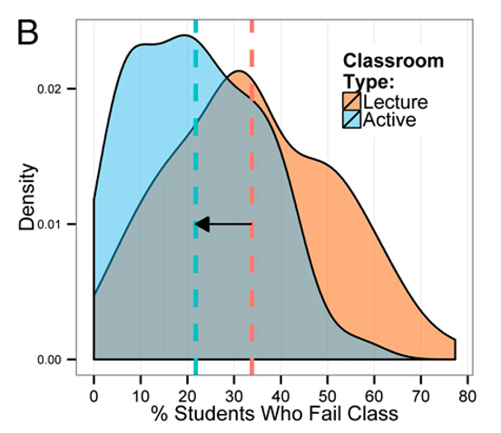
National Academy of Science (2014)
“lecturing increases failure rates by 55%”
(p. 8412)
Kernel density plots of failure rates under active learning and under lecturing. The mean failure rates under each classroom type (21.8% and 33.8%) are shown by dashed vertical lines. (p.8411)
Freeman, S., Eddy, S. L., McDonough, M., Smith, M. K., Okoroafor, N., Jordt, H., & Wenderoth, M. P. (2014). Active learning increases student performance in science, engineering, and mathematics. Proceedings of the National Academy of Sciences, 111(23), 8410-8415. http://www.pnas.org/content/111/23/8410.full.pdf
Notes:
Meta-analysis of 225 studies – STEM.

Slide 76
National Academy of Science (2014)
“If the experiments analyzed here had been conducted as randomized controlled trials of medical interventions, they may have been stopped for benefit—meaning that enrolling patients in the control condition might be discontinued because the treatment being tested was clearly more beneficial.”
Freeman, S., Eddy, S. L., McDonough, M., Smith, M. K., Okoroafor, N., Jordt, H., & Wenderoth, M. P. (2014). Active learning increases student performance in science, engineering, and mathematics. Proceedings of the National Academy of Sciences, 111(23), 8410-8415. http://www.pnas.org/content/111/23/8410.full.pdf
Notes:
Talking about Active Learning

Slide 77

Active Learning in Post-Secondary Mathematics Education
“… we call on institutions of higher education, mathematics departments and the mathematics faculty, public policy-makers, and funding agencies to invest time and resources to ensure that effective active learning is incorporated into post-secondary mathematics classrooms.”
https://www.cbmsweb.org/2016/07/active-learning-in-post-secondary-mathematics-education/

Slide 78
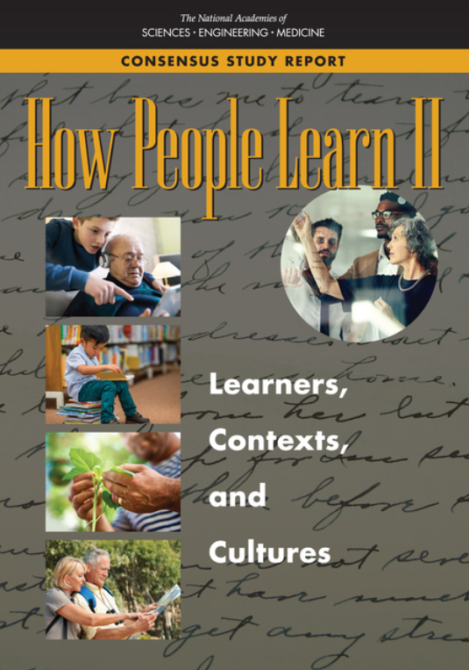
How People Learn II (2018)
“Quite literally, it is neurobiologically impossible to think deeply about or remember information about which one has had no emotion because the healthy brain does not waste energy processing information that does not matter to the individual (Immordino-Yang, 2015).” (p.30)
National Academies of Sciences, Engineering, and Medicine. (2018). How People Learn II: Learners, Contexts, and Cultures. Washington, DC: The National Academies Press. doi: https://doi.org/10.17226/24783

Slide 79
Ponder…
“…we have to shift away from teaching competencies that compete with what computers can do and start focusing on competencies that complement computer capabilities.”
Gravemeijer, K., Stephan, M., Julie, C., Lin, F. L., & Ohtani, M. (2017). What Mathematics Education May Prepare Students for the Society of the Future?. International Journal of Science and Mathematics Education, 15(1), 105-123. Quote p. 107.

Slide 80
Tallman, Carlson, Bressoud (2016)
Calculus I “exams generally require low levels of cognitive demand, seldom contain problems stated in a real-world context, rarely elicit explanation, and do not require students to demonstrate or apply their understanding of the course’s central ideas.”
Tallman, M. A., Carlson, M. P., Bressoud, D. M., & Pearson, M. (2016). A characterization of calculus I final exams in US colleges and universities. International Journal of Research in Undergraduate Mathematics Education, 2(1), 105-133.

Slide 81
Recent shifts through legislation:
CA (2017): AB705 - Colleges cannot require remedial courses unless “placement research” shows that students will be highly unlikely to succeed.
TX (2017): HB2223 – Co-requisite models are required.
Ownership.
Seymour-Campbell Student Success Act of 2012: matriculation: assessment. California Assembly Bill 705, (2018). https://leginfo.legislature.ca.gov/faces/billNavClient.xhtml?bill_id=201720180AB705
Texas House Bill 2223 (2017) https://capitol.texas.gov/tlodocs/85R/billtext/html/HB02223I.htm
Notes:
Talk about Ownership

Slide 82
AMATYC IMPACT (2018)
Proficiency expectations:
Know mathematics procedures and execute core computations fluently.
View mathematics as relevant to their daily lives.
Demonstrate evidence of mathematical understanding.
Utilize the structure in the mathematics.
Make sense of and solve problems.
Apply mathematics to everyday situations.
Communicate mathematically and do so with precision.
Defend their work and critique the work of others.
American Mathematical Association of Two-Year Colleges. (2018). IMPACT: Improving Mathematical Prowess And College Teaching. Memphis, TN: Author.

Slide 83
Revisit:
What does it mean to say a student is mathematically proficient?
Do your grades reflect that?

Slide 84
Looking forward

Slide 85
Changing Equations (LearningWorks)
“While the de-emphasis on intermediate algebra remains controversial, the math pathways movement resonates with other initiatives to focus community college education around structured pathways leading toward careers.”
Burdman, P. (2013). Changing equations: How community colleges are re-thinking college readiness in math. Oakland, CA: LearningWorks. p.5. Available at http://www.learningworksca.org/wp-content/uploads/2013/10/LWBrief_ChangingEquations_WEB.pdf

Slide 86
Degrees of Freedom (PACE/ LearningWorks)
“Access to algebra, in fact, has been considered a civil rights issue. This history leaves many cautious that alternative pathways would create separate but unequal tracks.”
Burdman, P. (2015). Degrees of Freedom: Diversifying Math Requirements for College Readiness and Graduation (Report 1 of a 3-Part Series). Policy Analysis for California Education, PACE. p.21. Available at http://edpolicyinca.org/sites/default/files/PACE%20Report%2004222015.pdf

Slide 87
Degrees of Freedom (PACE/ LearningWorks)
UCLA retired math professor Mark Green: “You have a danger of people being limited throughout their lives by what math they got early on—or didn’t. There’s a lot of stuff that uses Algebra 2, and students who don’t take it may be unaware that they are limiting their options later on.”
“On the other hand,” he acknowledges, “it’s much better to have someone who genuinely understands modeling and quantitative reasoning and has a feeling for statistics than someone who took an Algebra 2 class but is totally bewildered by it.”
Burdman, P. (2015). Degrees of Freedom: Diversifying Math Requirements for College Readiness and Graduation (Report 1 of a 3-Part Series). Policy Analysis for California Education, PACE. p.21. Available at http://edpolicyinca.org/sites/default/files/PACE%20Report%2004222015.pdf

Slide 88
Degrees of Freedom (PACE/ LearningWorks)
“Interestingly, both sides of the debate on alternatives are grounded in a concern about eliminating barriers for students: While proponents of alternative pathways view algebra-intensive curricula as a potential barrier to students’ success, critics fear that an education without advanced algebra itself constitutes a barrier.”
Burdman, P. (2015). Degrees of Freedom: Diversifying Math Requirements for College Readiness and Graduation (Report 1 of a 3-Part Series). Policy Analysis for California Education, PACE. p.22. Available at http://edpolicyinca.org/sites/default/files/PACE%20Report%2004222015.pdf

Slide 89
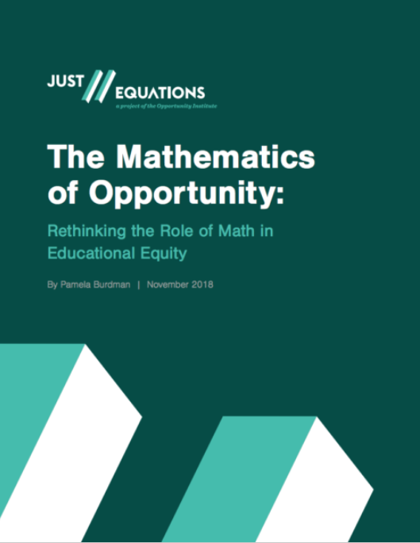
Just Equations (2018)
“New postsecondary math pathways and placement mechanisms have shown great promise for increasing equity in college attainment. Rather than face arbitrary requirements, students should be able to pursue pathways relevant to their interests, once they have learned core content.”
The Mathematics of Opportunity: Rethinking the Role of Math in Educational Equity. Just Equations, 2018. https://justequations.org/resource/the-mathematics-of-opportunity-report/. p. 22.

Slide 90
Intersegmental Chaos?
Notes:
To borrow a phrase from Phil Daro

Slide 91
Reflection: PROWESS
Proficiency
Procedural skills, understandings, applications, practices…
Ownership, Engagement, and Student Success
Pathways, placement, focus, coherence, rigor, connection to K12
Where do you go next?

Slide 92
Teaching and Learning Mathematics (After 20 years)
Ways of doing
Ways of thinking
Habits of thinking

Slide 93
Do your students habitually think:
Math is a collection of disconnected facts and algorithms
Math is coherent and founded on relationships of ideas.
Math is idiosyncratic and situation specific
Math is logical and systematic
Math is about quick answer-getting
Math is about authentic problem solving
Math is only important for mathematicians
Math is relevant to everyone
Math is to be memorized as given
Math is about constructing knowledge
Heavily Inspired by the taxonomy of the “Views About Mathematics Survey.” For more information see: Carlson, M. P. (1999). The mathematical behavior of six successful mathematics graduate students: Influences leading to mathematical success. Educational Studies in Mathematics, 40(3), 237-258. Only one bullet on this list is not from Carlson.

Slide 94
Do your students habitually think:
Math is for the talented few
Math is available to anyone willing to make the effort.
My effort has no impact on my ability to learn math: I am not a math person.
My achievement depends on my persistence.
Heavily Inspired by the taxonomy of the “Views About Mathematics Survey.” For more information see: Carlson, M. P. (1999). The mathematical behavior of six successful mathematics graduate students: Influences leading to mathematical success. Educational Studies in Mathematics, 40(3), 237-258. Only one bullet on this list is not from Carlson.

Slide 96
Thank You!
http://www.tedcoe.com/math/az19
tcoe@achieve.org
@drtedcoe

Slide 98
extras

