Slide 1
Rethinking Cognitive Complexity: Are Your Materials Reaching the Depth of the Math Standards?
April 3, 2019
Ted Coe, Director, Mathematics, Achieve, Inc. @drtedcoe
Shelbi Cole, Senior Mathematics Specialist, SAP @ShelbiCole1

Slide 2
http://tedcoe.com/math/SD2019

Slide 3
What I said/ What you heard
•What does proficiency mean in your classroom(s)? [Not a cut score…what does it actually mean?]
•How do you know when a student is proficient?

Slide 4
What do others hear when you use the word rigor?
What do you mean when you use the word rigor? Be as specific as possible.

Slide 5
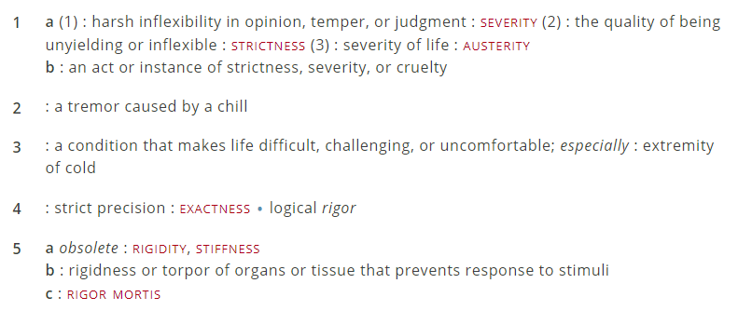
Definition
https://www.merriam-webster.com/dictionary/rigor

Slide 6
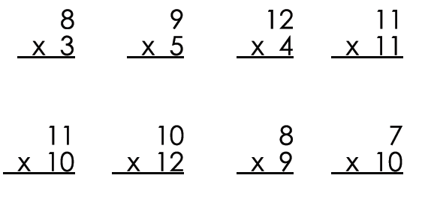

Slide 7
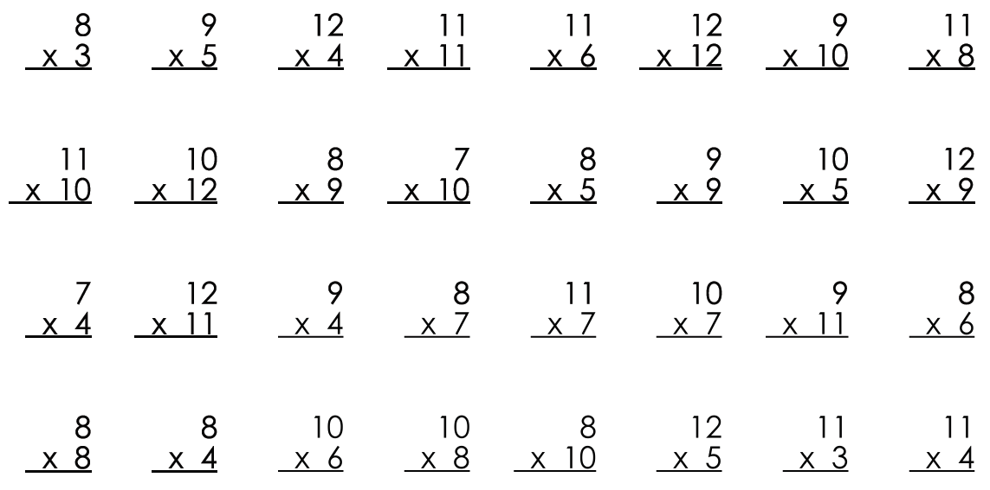

Slide 8
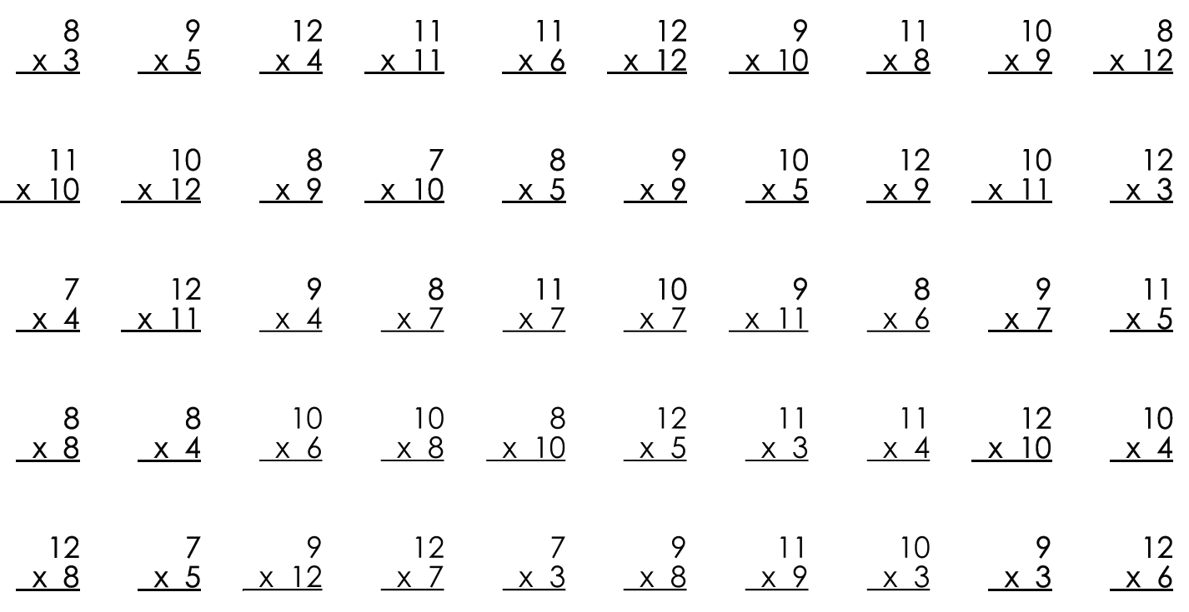

Slide 12
Jordan Ellenberg:
But, too often, we teach our students that “doing mathematics” means “manipulating clusters of digits according to rules presented to us by the teacher.”
That’s not math. And when we teach our students to do that, and only that, we are training them to be slow, buggy versions of Excel. What’s the point?
http://www.slate.com/blogs/how_not_to_be_wrong/2014/06/03/number_sentences_stephen_colbert_thinks_they_re_silly_they_re_not.html

Slide 13



The Shifts What makes college- and career-ready standards different?
Focus strongly where the standards focus.
Coherence: Think across grades and link to major topics within grades.
Rigor: In major topics, pursue conceptual understanding, procedural skill and fluency, and application with equal intensity.

Slide 14
Everything must be grounded in the Shifts!
Math: Focus, Coherence, & Rigor
ELA: Complexity, Evidence, & Knowledge
Instruction: Teaching & Learning
Assessment
Instructional Materials
Instructional Practice Guide
CCSSO Criteria for Evaluating and Procuring High-Quality Assessments
Publishers’ Criteria
Instructional Practice Toolkit
Aspects of Rigor Matrix & Indicators for SMPs
*Math Only
Instructional Materials Evaluation Tool (IMET); EQUIP Rubrics
SAP Item Alignment Modules
Ed Reports
Notes:
This is just a sample of tools available.

Slide 15
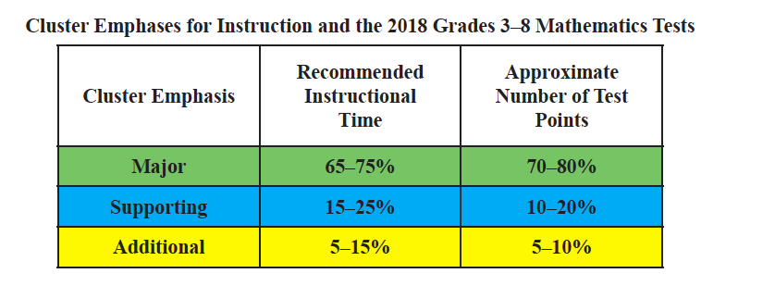
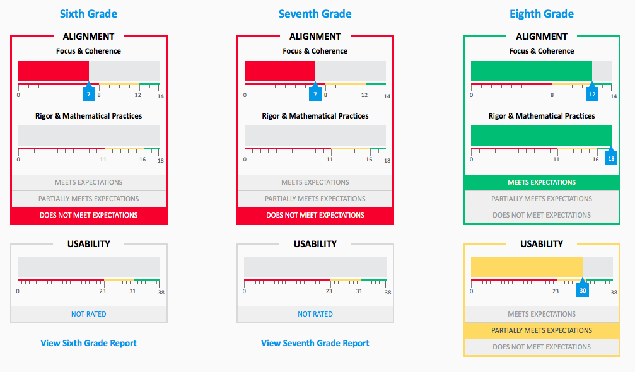
Why look at the Shifts from a systems perspective?
Summative State Blueprint (Example from New York)
Ed Reports Analysis of one Grades 6-8 Math Program

Slide 16
Mathematics – Assessment

Slide 17
RAND (2016)
“Yet, we also observed some differences in the aspects of rigor that
teachers chose depending on the students they serve.”
…
“These differences are not conclusive but suggest that teachers in lower-income schools and those who have spent more years in the classroom could be focusing more attention on procedural skill and fluency compared to conceptual understanding when teaching standards.”

Slide 18
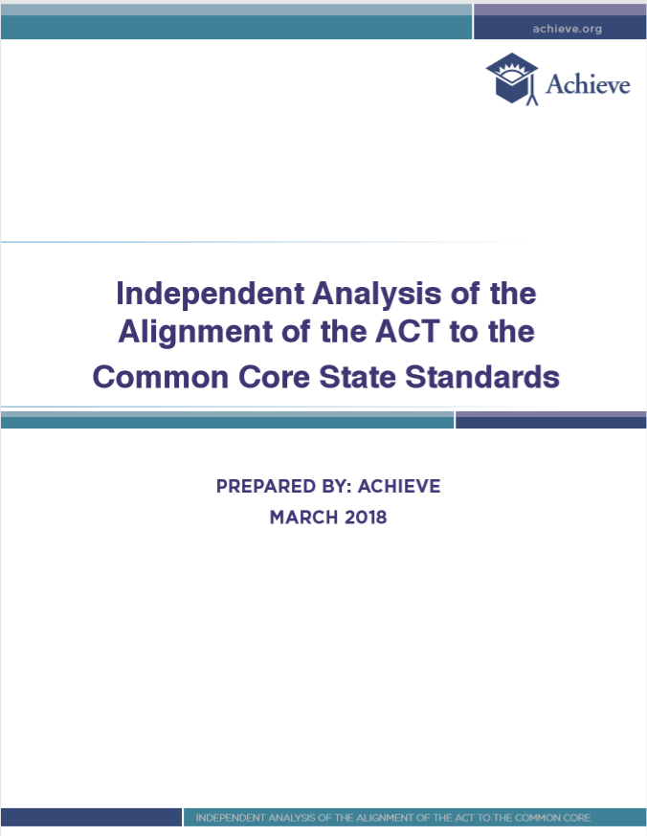

Slide 19
CCSSO Assessment Criteria: Section C
Criterion C.1: Focusing strongly on the content most needed for success in later mathematics
Criterion C.2: Assessing a balance of concepts, procedures, and applications
Criterion C.3: Connecting practice to content
Criterion C.4: Requiring a range of cognitive demand
Criterion C.5: Ensuring high-quality items and a variety of item types
https://www.ccsso.org/resource-library/criteria-procuring-and-evaluating-high-quality-assessments
Notes:
Section C was written to apply to all assessments based on college and career readiness (CCR) standards in Mathematics, including but not limited to the Common Core State Standards (CCSS).
This section is based on the research that describes what readiness is and how to help students attain readiness.
All criteria in Section C have corresponding evidence descriptors that apply to College and Career Readiness (CCR) standards, including the Common Core State Standards (CCSS).
A few evidence descriptors apply specifically to Common Core assessment by providing details drawn from the standards themselves.

Slide 20
CCSSO Assessment Criteria: Section C
Criterion C.1: Focusing strongly on the content most needed for success in later mathematics
Criterion C.2: Assessing a balance of concepts, procedures, and applications
Criterion C.3: Connecting practice to content
Criterion C.4: Requiring a range of cognitive demand
Criterion C.5: Ensuring high-quality items and a variety of item types
https://www.ccsso.org/resource-library/criteria-procuring-and-evaluating-high-quality-assessments
Notes:
Section C was written to apply to all assessments based on college and career readiness (CCR) standards in Mathematics, including but not limited to the Common Core State Standards (CCSS).
This section is based on the research that describes what readiness is and how to help students attain readiness.
All criteria in Section C have corresponding evidence descriptors that apply to College and Career Readiness (CCR) standards, including the Common Core State Standards (CCSS).
A few evidence descriptors apply specifically to Common Core assessment by providing details drawn from the standards themselves.

Slide 21
CCSSO Criterion C.2
C.2 Assessing a balance of concepts, procedures, and applications: The assessments measure conceptual understanding, fluency and procedural skill, and application of mathematics, as set out in college- and career-ready standards.
Notes:
Common issues observed:
Lack of PSF items
Overemphasizing APP for PSF standards
Insufficient number of CU items
CU items not at the depth called for in the standards

Slide 22
“To prepare students for Algebra, the curriculum must simultaneously develop conceptual understanding, computational fluency, and problem- solving skills…These capabilities are mutually supportive, each facilitating learning of the others.” -National Mathematics Advisory Panel, 2008 National Mathematics Advisory Panel. (2008). Foundations for success: The final report of the National Mathematics Advisory Panel. Washington, DC: U.S. Department of Education. Retrieved from https://www2.ed.gov/about/bdscomm/list/mathpanel/report/final-report.pdf p. xix.

Slide 23
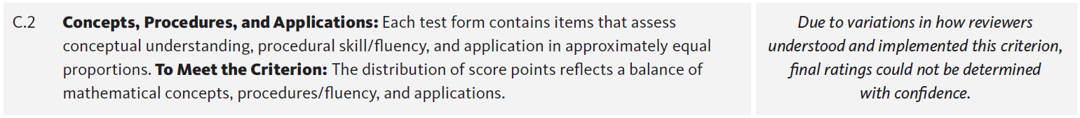
Fordham Institute, 2016
Doorey, N., & Polikoff, M. (2016). Evaluating the content and quality of next generation assessments. Thomas B. Fordham Institute. https://edexcellence.net/publications/evaluating-the-content-and-quality-of-next-generation-assessments. p. 18.

Slide 24
The Aspects of Rigor (AOR) Matrix
 | The item does not involve application. | The item involves an application.
The item targets procedural skill expected by the grade level. | P | P-A
The item targets conceptual understanding and procedural skill expected by the grade level OR targets conceptual understanding but can also be answered using at least some procedural skill expected by the grade level. | P-C | P-C-A
The item targets conceptual understanding. Students may explain, strategize, evaluate, determine, compare, or classify. | C | C-A
A procedure is a step-by-step sequence that can be memorized and executed without understanding or attending to the meaning of the quantities; a procedure is useful for a class of problems or situations. Computations that are likely to be known from memory are considered procedural.
Conceptual understanding refers to the mathematics used to respond to an item, not the complexity of the question itself.
Names or mathematical referents (e.g., units of measure) may be present in item, but should not be considered application in the sense intended by the shifts in CCR standards.

Slide 25
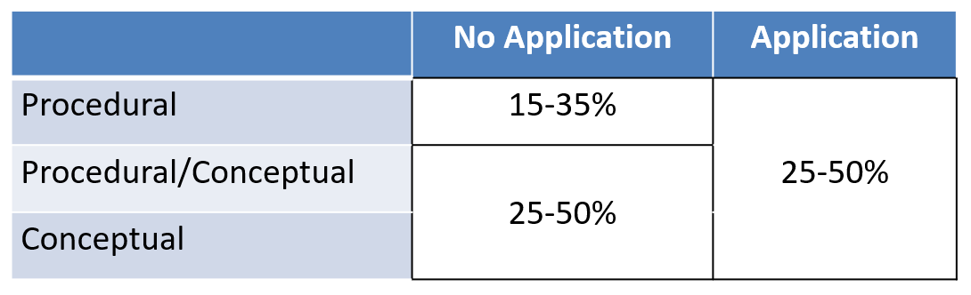

Slide 26
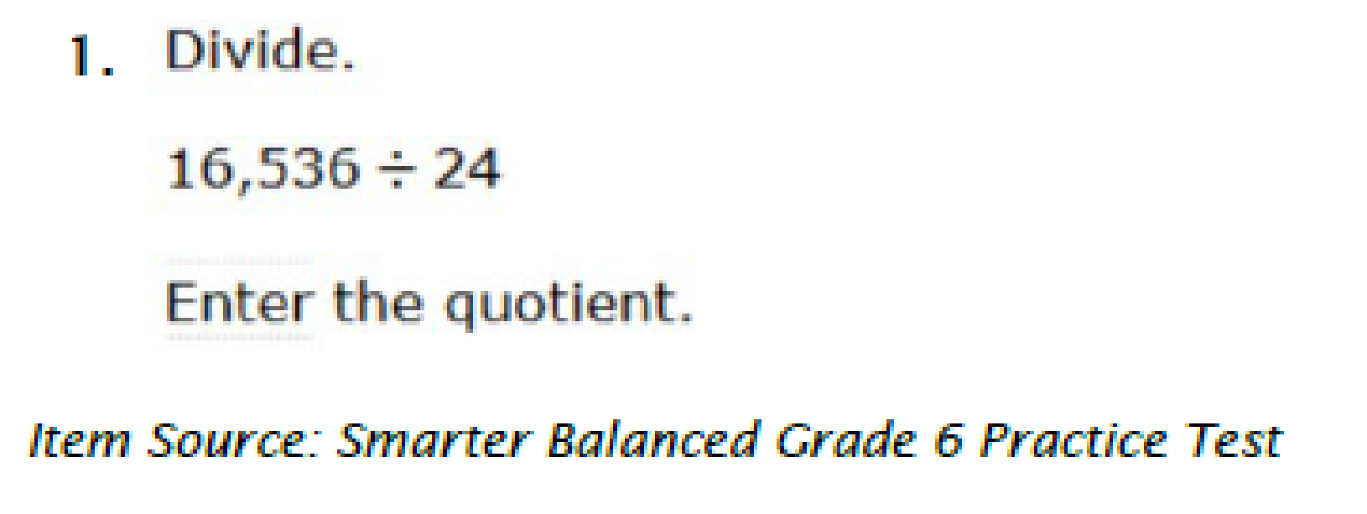
This item is coded as PSF. By the end of grade 6, multi-digit division can be done by carrying out a known set of steps.

Slide 27
Required Fluencies in K-6
Grade | Standard | Required Fluency
K | K.OA.5 | Add/subtract within 5
1 | 1.OA.6 | Add/subtract within 10
2 | 2.OA.2 2.NBT.5 | Add/subtract within 20 (know single-digit sums from memory) Add/subtract within 100
3 | 3.OA.7 3.NBT.2 | Multiply/divide within 100 (know single-digit products from memory) Add/subtract within 1000
4 | 4.NBT.4 | Add/subtract within 1,000,000
5 | 5.NBT.5 | Multi-digit multiplication
6 | 6.NS.2,3 | Multi-digit division Multi-digit decimal operations
Notes:
Talking Points:
There are specific required fluencies named in the Standards for grades K-6. (These are only the fluencies named in the Standards, not all of the procedural skills.) They do not have to be taught in isolation, but can be reinforced through other concepts.
Fluent means FAST and ACCURATE.
Fluency is different for each grade level. Some fluencies are with paper and pencil (third grade’s add/subtract within 1000 and fourth grade), some by memory.
Although procedural skill continues past grade 6, all the fluency standards are wrapped up by grade 6 to ensure students are ready for the work of Algebra.

Slide 28
Fluency in State Standards (AZ, in this case)
Efficiency
carries out easily, keeps track of sub-problems, and makes use of intermediate results to solve the problem.
Accuracy
reliably produces the correct answer.
Flexibility
knows more than one approach, chooses a viable strategy, and uses one method to solve and another method to doublecheck.
Appropriately
knows when to apply a particular procedure.
According to the December, 2016 Arizona Mathematics Standards, p. 15.

Slide 29
Question:
How many years was it from December 7, 1941 to December 7, 2014?
How did you figure it out?

Slide 30
Step 1: Notice the subtraction exercise.
2014-1941
Step 2: Set up the problem in a template.
2014
-1941
Step 3: Work from right to left. Subtract 1 from 4.
2014
-1941
3
Step 4. Got it. Now move one column to the left. Subtract 4 from 1.
Step 5. Realize that I cannot subtract 4 from 1.
Step 6. Remember that I need to “borrow” from the next column to the left.
Step 7. Notice there is nothing to borrow. (Perhaps also consider how I wasn’t going to ever give it back anyway.)
Step 8. Borrow from the 2 in the far left column. Make it a 1.
Step 9. Think of the “0” in the top row as a 10. Wedge a tiny 1 between the 2 and the 0. Some might want to make it a little higher than the 0.
Step 10. Now borrow from the newly made 10. Make it a 9 by crossing out the 0 and 1 you just created during the previous step

Slide 31
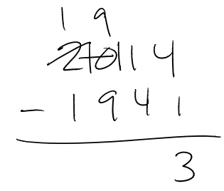
Step 11. Wedge a tiny 1 to the left of the original 1. I now have something that looks like this:
Step 12. Subtract 4 from the newly-made 11. Get 7.
Step 13. Subtract 9 from 9.
Step 14. Subtract 1 from 1.
Step 15. Declare the answer to be 73.

Slide 32
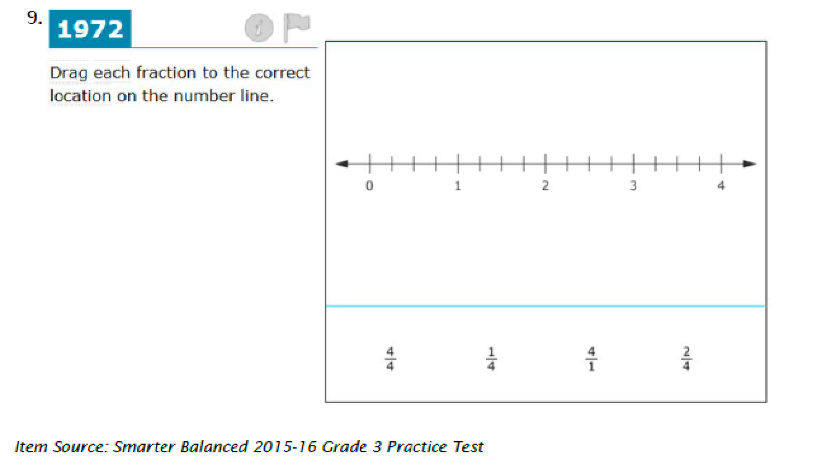
This item is coded as C. The question asks students to represent fractions on a number line diagram which requires a strong understanding of fractions as numbers, including the meaning of the numerator and denominator and how that relates to the way the number line partitioned.

Slide 33
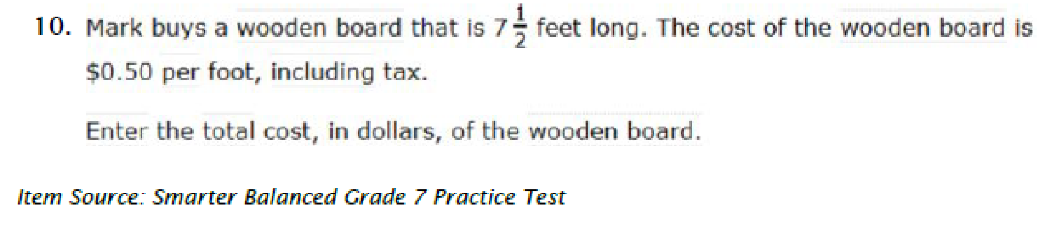
This item is coded as P-A. The item resembles a standard application of mathematics in the real world, computing total cost based on a unit rate. Students use procedural skill to compute the total cost.

Slide 34
Identifying Concepts, Procedures, and Applications
It’s a conceptual understanding item if…
It assesses a mathematical concept
It rewards understanding of a targeted concept over brute force skill.
It’s a procedural skill and/or fluency item if…
Students use a known, step-by-step process to solve the item
Students can solve from memory
It’s an application item if…
There is a real-life, non-trivial context
Notes:
These statements may come in handy as you review problems in our first activity for a balance of concepts, procedures and application.
handout

Slide 35
CCSSO Assessment Criteria: Section C
Criterion C.1: Focusing strongly on the content most needed for success in later mathematics
Criterion C.2: Assessing a balance of concepts, procedures, and applications
Criterion C.3: Connecting practice to content
Criterion C.4: Requiring a range of cognitive demand
Criterion C.5: Ensuring high-quality items and a variety of item types
https://www.ccsso.org/resource-library/criteria-procuring-and-evaluating-high-quality-assessments
Notes:
Section C was written to apply to all assessments based on college and career readiness (CCR) standards in Mathematics, including but not limited to the Common Core State Standards (CCSS).
This section is based on the research that describes what readiness is and how to help students attain readiness.
All criteria in Section C have corresponding evidence descriptors that apply to College and Career Readiness (CCR) standards, including the Common Core State Standards (CCSS).
A few evidence descriptors apply specifically to Common Core assessment by providing details drawn from the standards themselves.

Slide 36
CCSSO Assessment Criteria: Section C
Criterion C.1: Focusing strongly on the content most needed for success in later mathematics
Criterion C.2: Assessing a balance of concepts, procedures, and applications
Criterion C.3: Connecting practice to content
Criterion C.4: Requiring a range of cognitive demand
Criterion C.5: Ensuring high-quality items and a variety of item types
https://www.ccsso.org/resource-library/criteria-procuring-and-evaluating-high-quality-assessments
Notes:
Section C was written to apply to all assessments based on college and career readiness (CCR) standards in Mathematics, including but not limited to the Common Core State Standards (CCSS).
This section is based on the research that describes what readiness is and how to help students attain readiness.
All criteria in Section C have corresponding evidence descriptors that apply to College and Career Readiness (CCR) standards, including the Common Core State Standards (CCSS).
A few evidence descriptors apply specifically to Common Core assessment by providing details drawn from the standards themselves.

Slide 37
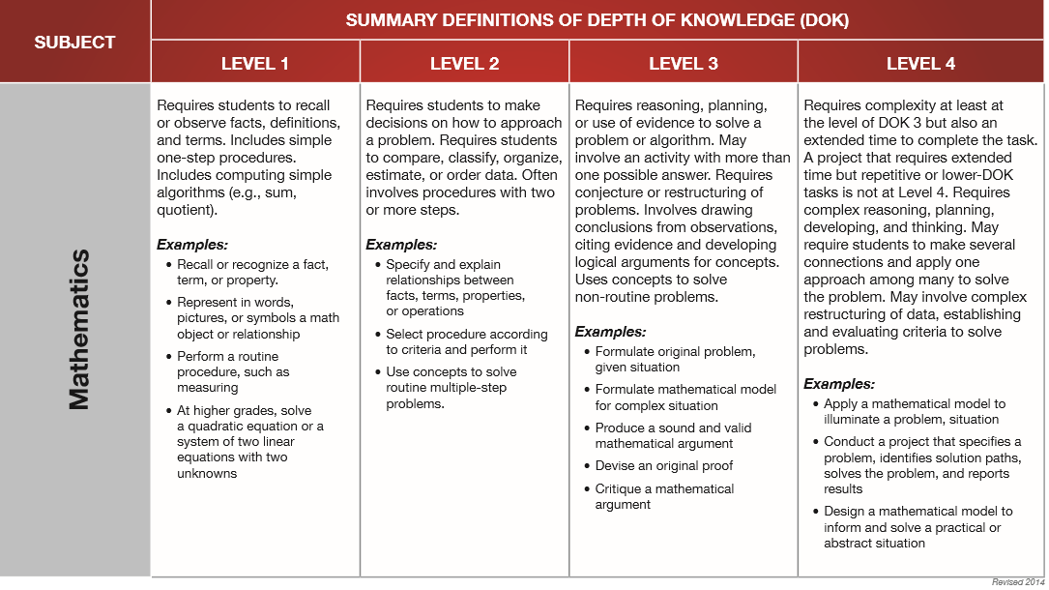
Depth Of Knowledge
http://www.webbalign.org/Webbs-DOK-Levels-Summary.pdf

Slide 38

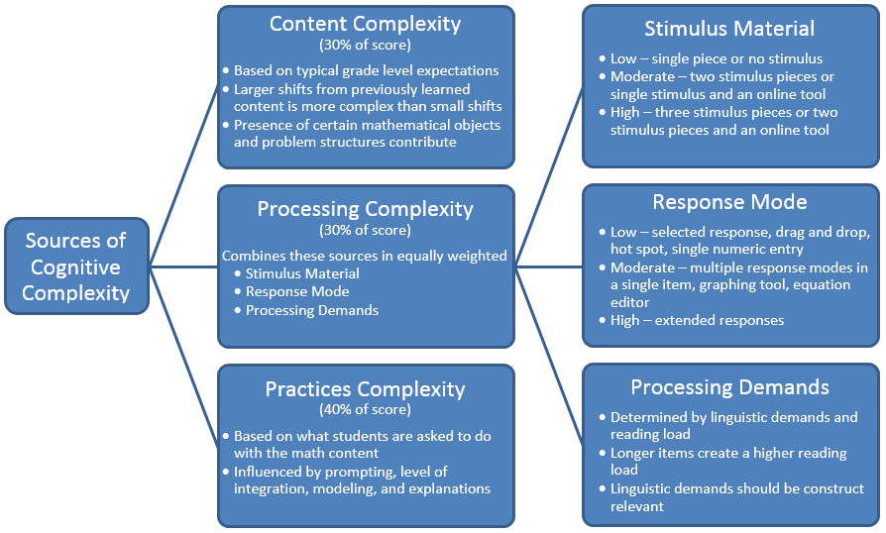
http://www.parcconline.org/files/100/Mathematics%20Cognitive%20Complexity%20Framework/184/CognitiveComplexityOnePager-Math.docx

Slide 39
CCSSO Criterion C.4
C.4 Requiring a range of cognitive demand: The assessments require all students to demonstrate a range of higher-order, analytical thinking skills in mathematics based on the depth and complexity of college- and career-ready standards, allowing robust information to be gathered for students with varied levels of achievement. Assessments include questions, tasks, and prompts about the basic content of the grade or course as well as questions that reflect the complex challenge of college- and career-ready standards.

Slide 40
Recommendation for New Classification System
The CCSSO criterion C.4 suggests the use of classifications specific to the discipline and drawn from mathematical factors, such as
the mathematical topic coverage,
the nature of reasoning,
the nature of computation,
the nature of applications, and
the required cognitive actions.
This guidance presents the opportunity to build a stronger relationship between C.2 and C.4

Slide 41
So we tried to do just that…
 | The item does not involve application. | The item involves an application.
The item targets procedural skill expected by the grade level. | P | P-A
The item targets conceptual understanding and procedural skill expected by the grade level OR targets conceptual understanding but can also be answered using at least some procedural skill expected by the grade level. | P-C | P-C-A
The item targets conceptual understanding. Students may explain, strategize, evaluate, determine, compare, or classify. | C | C-A
How can we talk about procedural, conceptual, and application complexity?

Slide 42
Procedural Complexity
 | Level 1 | Level 2 | Level 3
Procedural Complexity:¹ | Solving the problem entails little procedural demand or procedural demand² is below grade level. | Solving the problem entails common or grade-level procedure(s) with friendly numbers. | Solving the problem requires common or grade-level procedure(s) with unfriendly numbers,³ an unconventional combination of procedures, or requires unusual perseverance or organizational skills in the execution of the procedure(s).
^{[1]} This is based on the NAEP States Item to Item Comparison Study, NAEP Validity Studies Panel; Philip Daro, Gerunda Hughes, Sami Kamito, Fran Stancavage, Natalie Tucker-Bradway; American Institutes for Research, 2018.
^{[2]} A procedure is a step by step sequence that can be memorized and executed without understanding or attending to the meaning of the quantities; a procedure is useful for a class of problems or situations. Computations that are likely to be known from memory are considered procedural.
^{[3]} Unfriendly numbers: The student is likely to get the problem wrong not because of the targeted procedure but because of the numbers involved.

Slide 43
Conceptual Complexity
 | Level 1 | Level 2 | Level 3
Conceptual Complexity:¹ | Solving the problem requires students to recall or recognize a grade-level concept. The student does not need to relate concepts or demonstrate a line of reasoning. | Students may need to relate multiple grade-level concepts of different types, create multiple representations or solutions, or connect concepts with procedures or strategies. The student must do some reasoning, but may not need to demonstrate a line of reasoning. | Solving the problem requires students to relate multiple grade-level concepts and to evidence reasoning, planning, analysis, judgment, and/or creative thought OR work with a sophisticated (nontypical) line of reasoning.
^{[4]} This is based on the conceptual aspects of the Mathematics Framework for the 2015 National Assessment of Educational Progress; National Assessment Governing Board, 2014.

Slide 44
Application Complexity
 | Level 1 | Level 2 | Level 3
Application Complexity: | Solving the problem entails an application of mathematics, but the required mathematics is either directly indicated or obvious. | Solving the problem entails an application of mathematics and requires an interpretation of the context to determine the procedure or concept (may include extraneous information). The mathematics is not immediately obvious. Solving the problem requires students to decide what to do. | In addition to an interpretation of the context, solving the problem requires recognizing important features, and formulating, computing, and interpreting results as part of a modeling process.

Slide 45
 | Level 1 | Level 2 | Level 3
Procedural Complexity: | Solving the problem entails little procedural demand or procedural demand is below grade level. | Solving the problem entails common or grade-level procedure(s) with friendly numbers. | Solving the problem requires common or grade-level procedure(s) with unfriendly numbers, an unconventional combination of procedures, or requires unusual perseverance or organizational skills in the execution of the procedure(s).
Application Complexity: | Solving the problem entails an application of mathematics, but the required mathematics is either directly indicated or obvious. | Solving the problem entails an application of mathematics and requires an interpretation of the context to determine the procedure or concept (may include extraneous information). The mathematics is not immediately obvious. Solving the problem requires students to decide what to do. | In addition to an interpretation of the context, solving the problem requires recognizing important features, and formulating, computing, and interpreting results as part of a modeling process.
Conceptual Complexity: | Solving the problem requires students to recall or recognize a grade-level concept. The student does not need to relate concepts or demonstrate a line of reasoning. | Students may need to relate multiple grade-level concepts of different types, create multiple representations or solutions, or connect concepts with procedures or strategies. The student must do some reasoning, but may not need to demonstrate a line of reasoning. | Solving the problem requires students to relate multiple grade-level concepts and to evidence reasoning, planning, analysis, judgment, and/or creative thought OR work with a sophisticated (nontypical) line of reasoning.

Slide 46
Grade 4
Procedural | Conceptual | Application
1 | 0 | 1
A baker has 159 cups of brown sugar and 264 cups of white sugar. How many total cups of sugar does the baker have?
In this Grade 4 item, the application makes the expected mathematical procedure clear. Adding two three-digit numbers is a fluency expectation from grade 3.
This item is from the Smarter Balanced Assessment Consortium: Mathematics Practice Test Scoring Guide Grade 4, 08/01/2016.

Slide 47
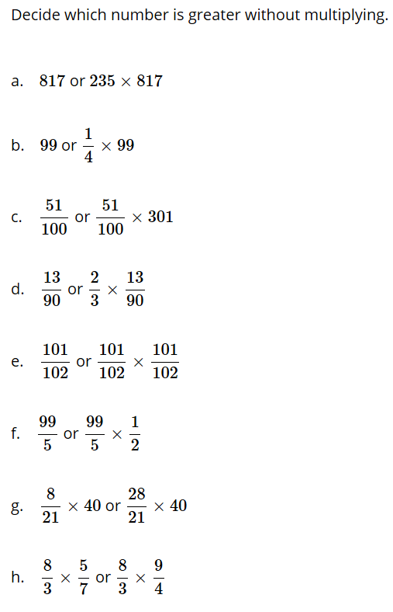

Grade 5
Procedural | Conceptual | Application
0 | 3 | 0
In this Grade 5 item students must use a sophisticated line of reasoning to compare the values.
This item is from the tasks for 5.NF.B.5 at Illustrative Mathematics.

Slide 48
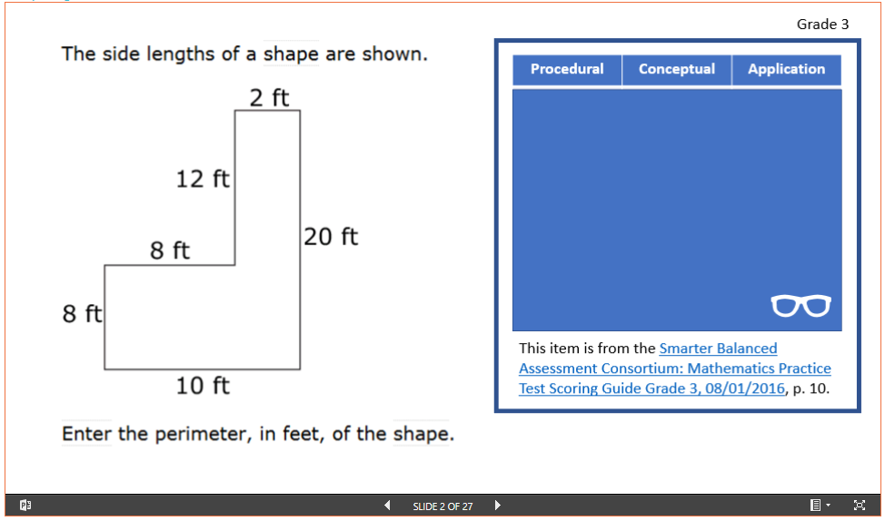
Activity 1: Your Turn, With Assistance
http://tedcoe.com/math/2019
Select a grade band
Try an item on your own, then discuss, then click the glasses to see what we selected.
Try a few more items

Slide 49
https://www.achieve.org/mathematics-assessment-cognitive-complexity-framework
(Scroll down for sample items)

Slide 50
The Challenge of Balance
Not all domains/clusters need to reflect all aspects.
In items that reflect multiple aspects, you cannot assign points to complexities.

Slide 51
Patrick Callahan:
“Rigor is defined by the variety and quality of the work produced by students.”
From Patrick Callahan’s presentation Systemwide Consequences of Misunderstanding Mathematical Rigor at the April 2018 NCSM National Conference in Washington, DC.

Slide 52
Other uses for the Matrix?
What can this do that other tools cannot?
Beyond assessment, how might you use the matrix in other ways?
Notes:
NCSM: tool you can place before teachers to reflect on classroom opportunities.
NCTM: Think about your own in-class tests. Think about in-class tasks. Think about what your students produce.

Slide 53
What does proficiency mean in your classroom(s)?
Do students’ grades reflect that?
What should proficiency mean in your classroom(s)?

Slide 54
Still More Work to Do
What does the “gold standard” assessment look like with respect to these criteria?

Slide 55
Assessment Design Considerations
Assessment of procedural skill should generally be at Level 2, except…
Some rich application or conceptual problems may purposely use Level 1 procedural skill to target higher levels of demand on the other dimensions
Level 3 procedural skill should be used cautiously and only with very clear purpose
Assessments should include application and conceptual problems at level 2 at all grades and level 3 at grades 7 and up.
To design Levels 2 & 3 application problems, it may be helpful to integrate SMP.4 with grade level application content standards
To design Levels 2 & 3 conceptual problems, it may be helpful to integrate SMP.3 with grade level conceptual content standards

Slide 56




Stay Connected
Subscribe for email updates on www.achieve.org and achievethecore.org
Follow us on social media:
Twitter: @AchieveInc @achievethecore
Facebook: facebook.com/achievethecore
Pinterest: pinterest.com/achievethecore

Slide 57
Thank you! Ted Coe, tcoe@achieve.org Shelbi Cole, scole@studentsachieve.net

Slide 58
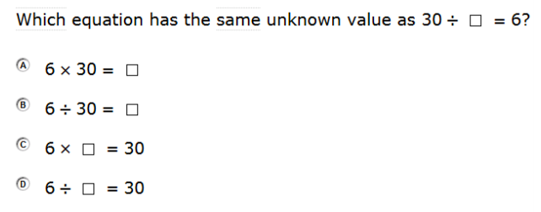
Grade 3
Procedural | Conceptual | Application
2 | 1
In this Grade 3 item, students must either recognize the relationship between multiplication and division or use grade level fluency to determine which equations have the same unknown.
This item is from the Smarter Balanced Assessment Consortium: Mathematics Practice Test Scoring Guide Grade 3, 08/01/2016, p. 14.

Slide 59
Grade 6 Example
Procedural | Conceptual | Application
1 | 0 | 1
Heather earns $8.00 per hour for walking a dog. How many hours must she work to earn $256.00?
In this Grade 6 item (administered without a calculator) the required computation is below grade level. As to application, the required mathematics is rather obvious at this grade level.
This item is from the North Carolina READY End-of-Grade Assessment Mathematics Grade 6 Student Booklet, p. 7.

Slide 60
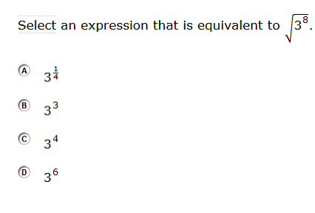
High School Example
Procedural | Conceptual | Application
2 | 0 | 0
This high-school level task is procedural and at grade level. High school students are expected to rewrite expressions involving radicals and rational exponents.
This item is from the Smarter Balanced Assessment Consortium: Mathematics Practice Test Scoring Guide High School, 08/01/2016, p. 4.

Slide 61
Grade 6
Procedural | Conceptual | Application
3 | 0 | 2
At a store, Susan selected a pumpkin that weighed 35.2 ounces.
Pumpkins cost $1.80 per pound
There are 16 ounces in 1 pound
How much did Susan’s pumpkin cost?
Express the answer as dollars.cents.
In this Grade 6 item (administered without a calculator), the procedure is level 3 due to the unfriendly numbers. In this case, the application must be interpreted to determine the procedures to use.
This item is from the North Carolina READY End-of-Grade Assessment Mathematics Grade 6 Student Booklet, p. 6.

Slide 62
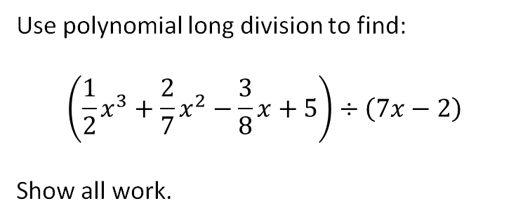
High School
Procedural | Conceptual | Application
3 | 0 | 0
In this task students have to work with unfriendly numbers. A student may know the procedure very well, yet get an incorrect answer due to the numbers involved. The task also requires unusual perseverance.

Slide 63
Grade 5
Procedural | Conceptual | Application
0 | 3 | 0
In this Grade 5 item students must use a sophisticated line of reasoning to compare the values.
This item is from the tasks for 5.NF.B.5 at Illustrative Mathematics.

Slide 64
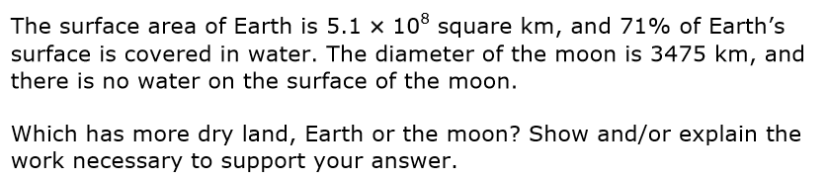
Grade 8
Procedural | Conceptual | Application
3 | 3 | 2
In this Grade 8 item students must demonstrate a sophisticated line of reasoning. Procedurally, the students work with an unconventional combination of procedures. The students must use the quantities in the context to determine the procedures and concepts to use.
This item is from the Smarter Balanced Scoring Guide For Selected Short-Text Mathematics Items (Field Test 2014), p. 17.
Notes:
Administered with calculator

Slide 65
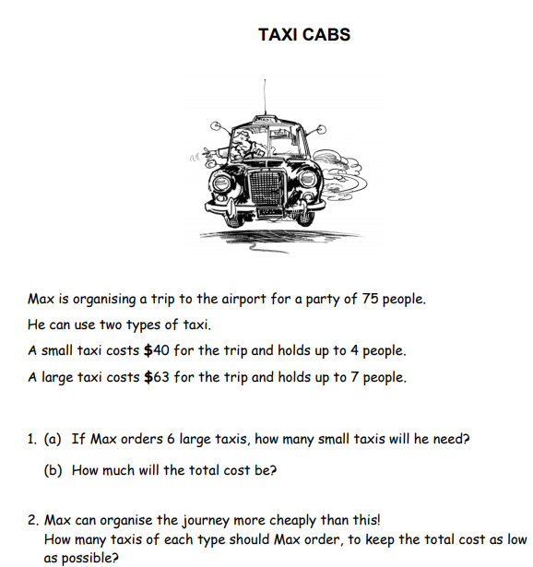
Middle School
Procedural | Conceptual | Application
1 | 0 | 3
In this middle school item, students need to use the application to determine the mathematics, and they need to formulate and interpret results. The required procedures (which are not the aim of the task) are below grade level.
This item, Taxi Cabs, is from the Mathematics Assessment Resource Service’s Summative Assessment Tasks and may be accessed here.

